Slide 1
Antineutrino interactions below the IBD threshold
Let’s share our ideas, information and tools

Slide 2


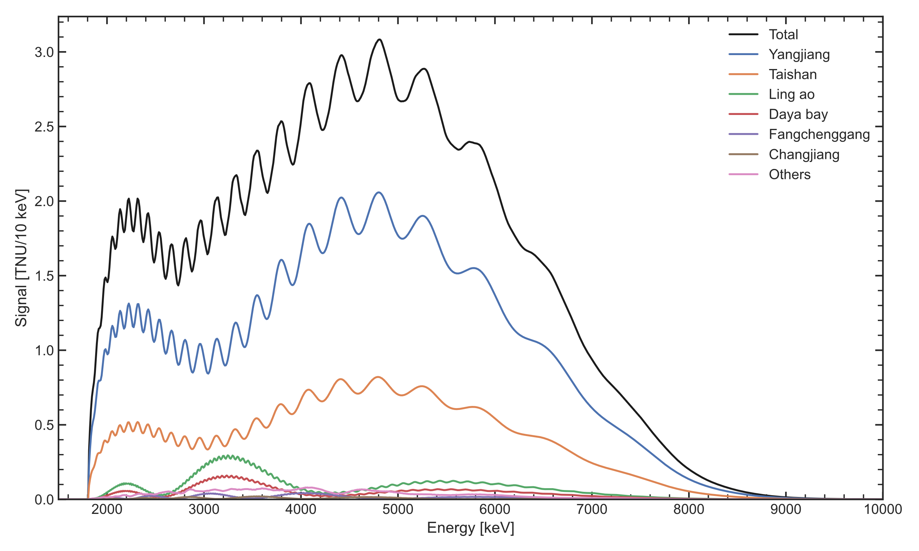
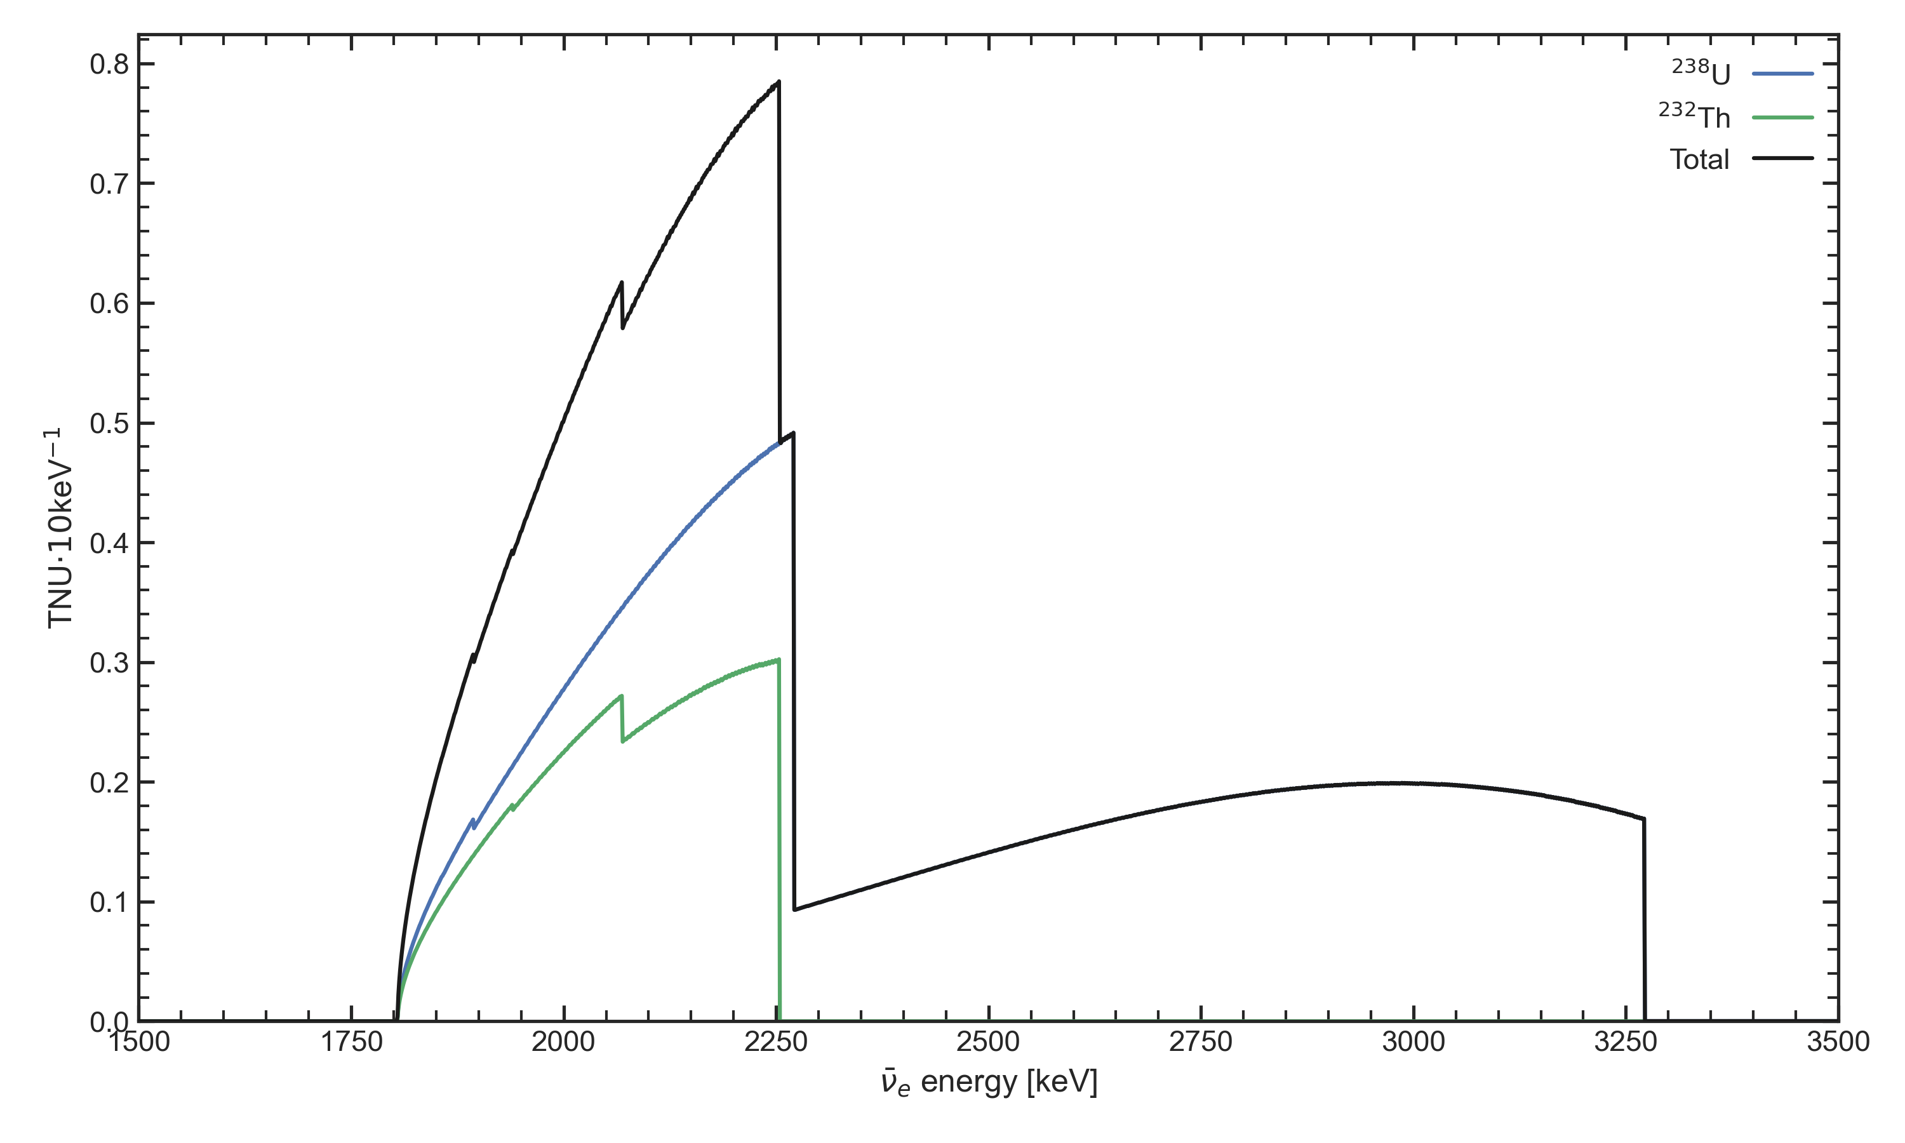
Main sources of antineutrinos
For comparison: Solar neutrinos flux ∽ 10¹¹ cm⁻² s⁻¹
Reactors
Flux ∽ 10⁸ cm⁻² s⁻¹
Energy range 0 MeV – 10 MeV
Earth
Flux ∽ 10⁷ cm⁻² s⁻¹
Energy range 0 MeV – 3 MeV

Slide 3
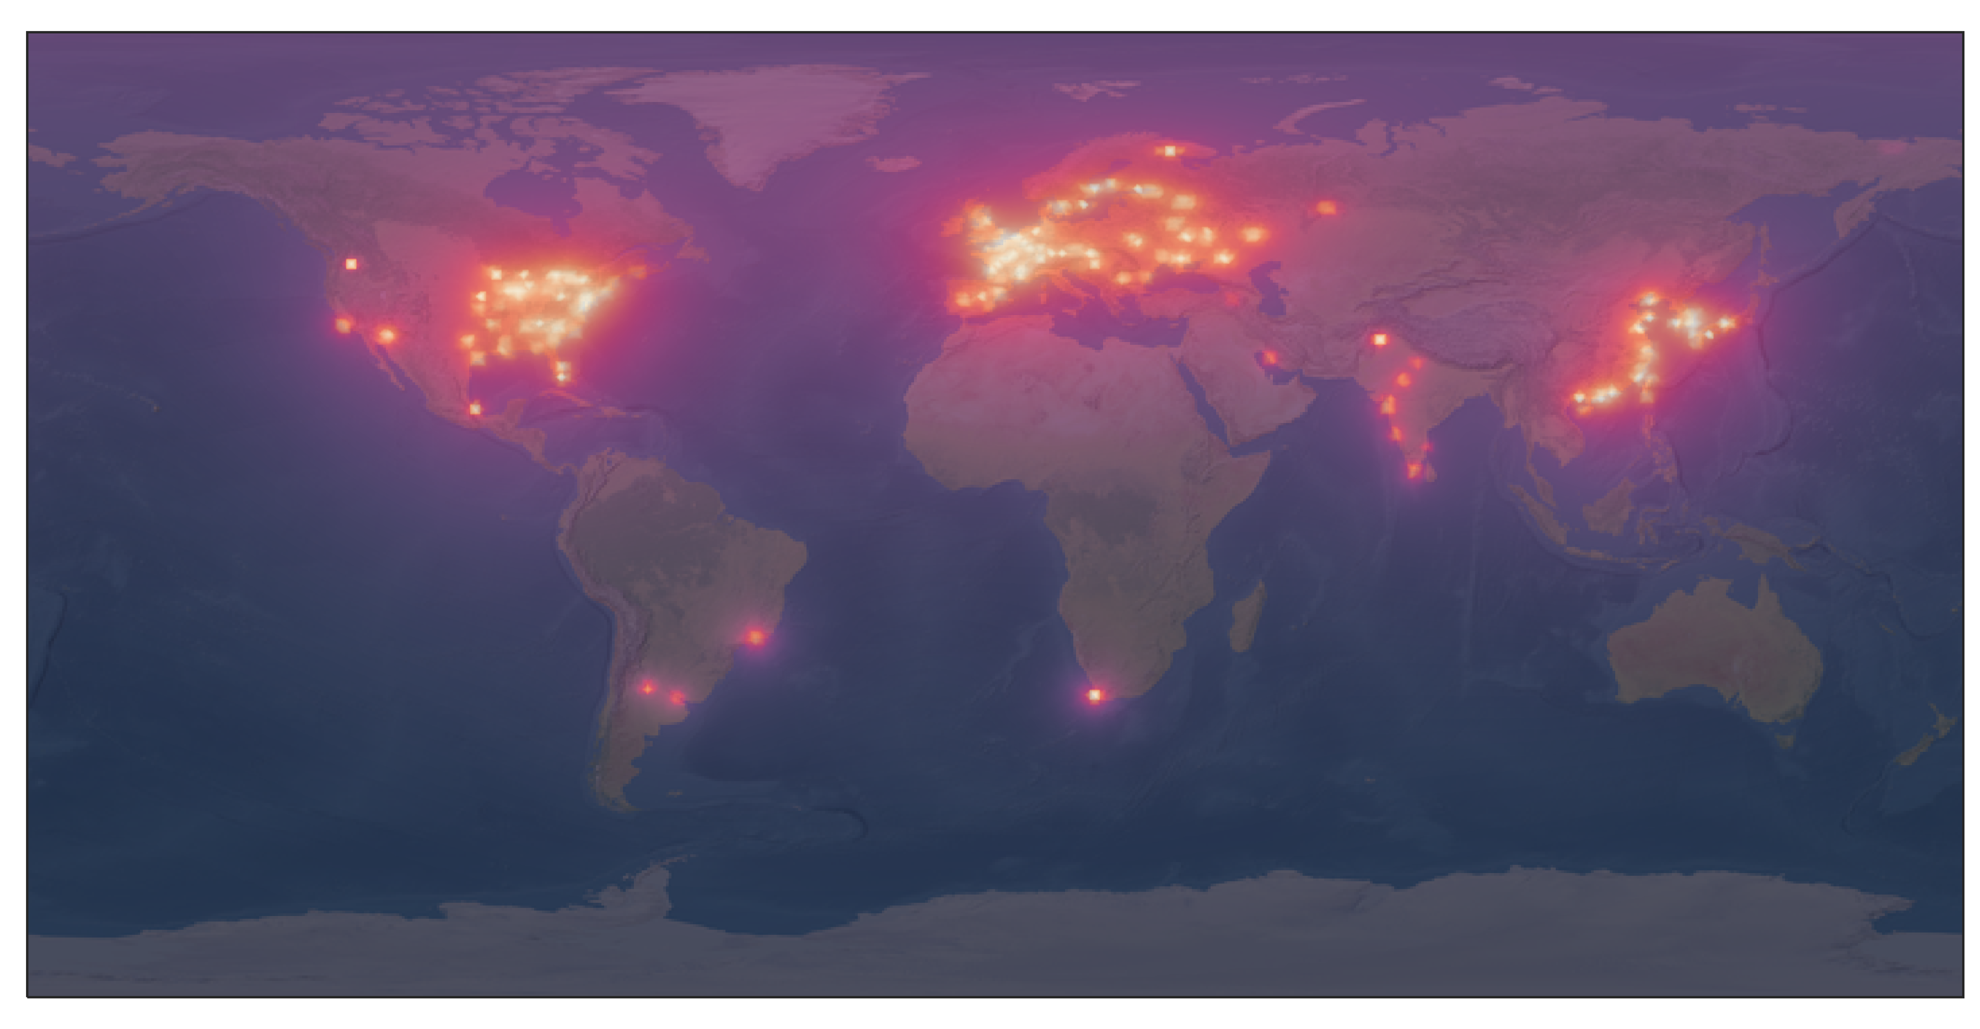
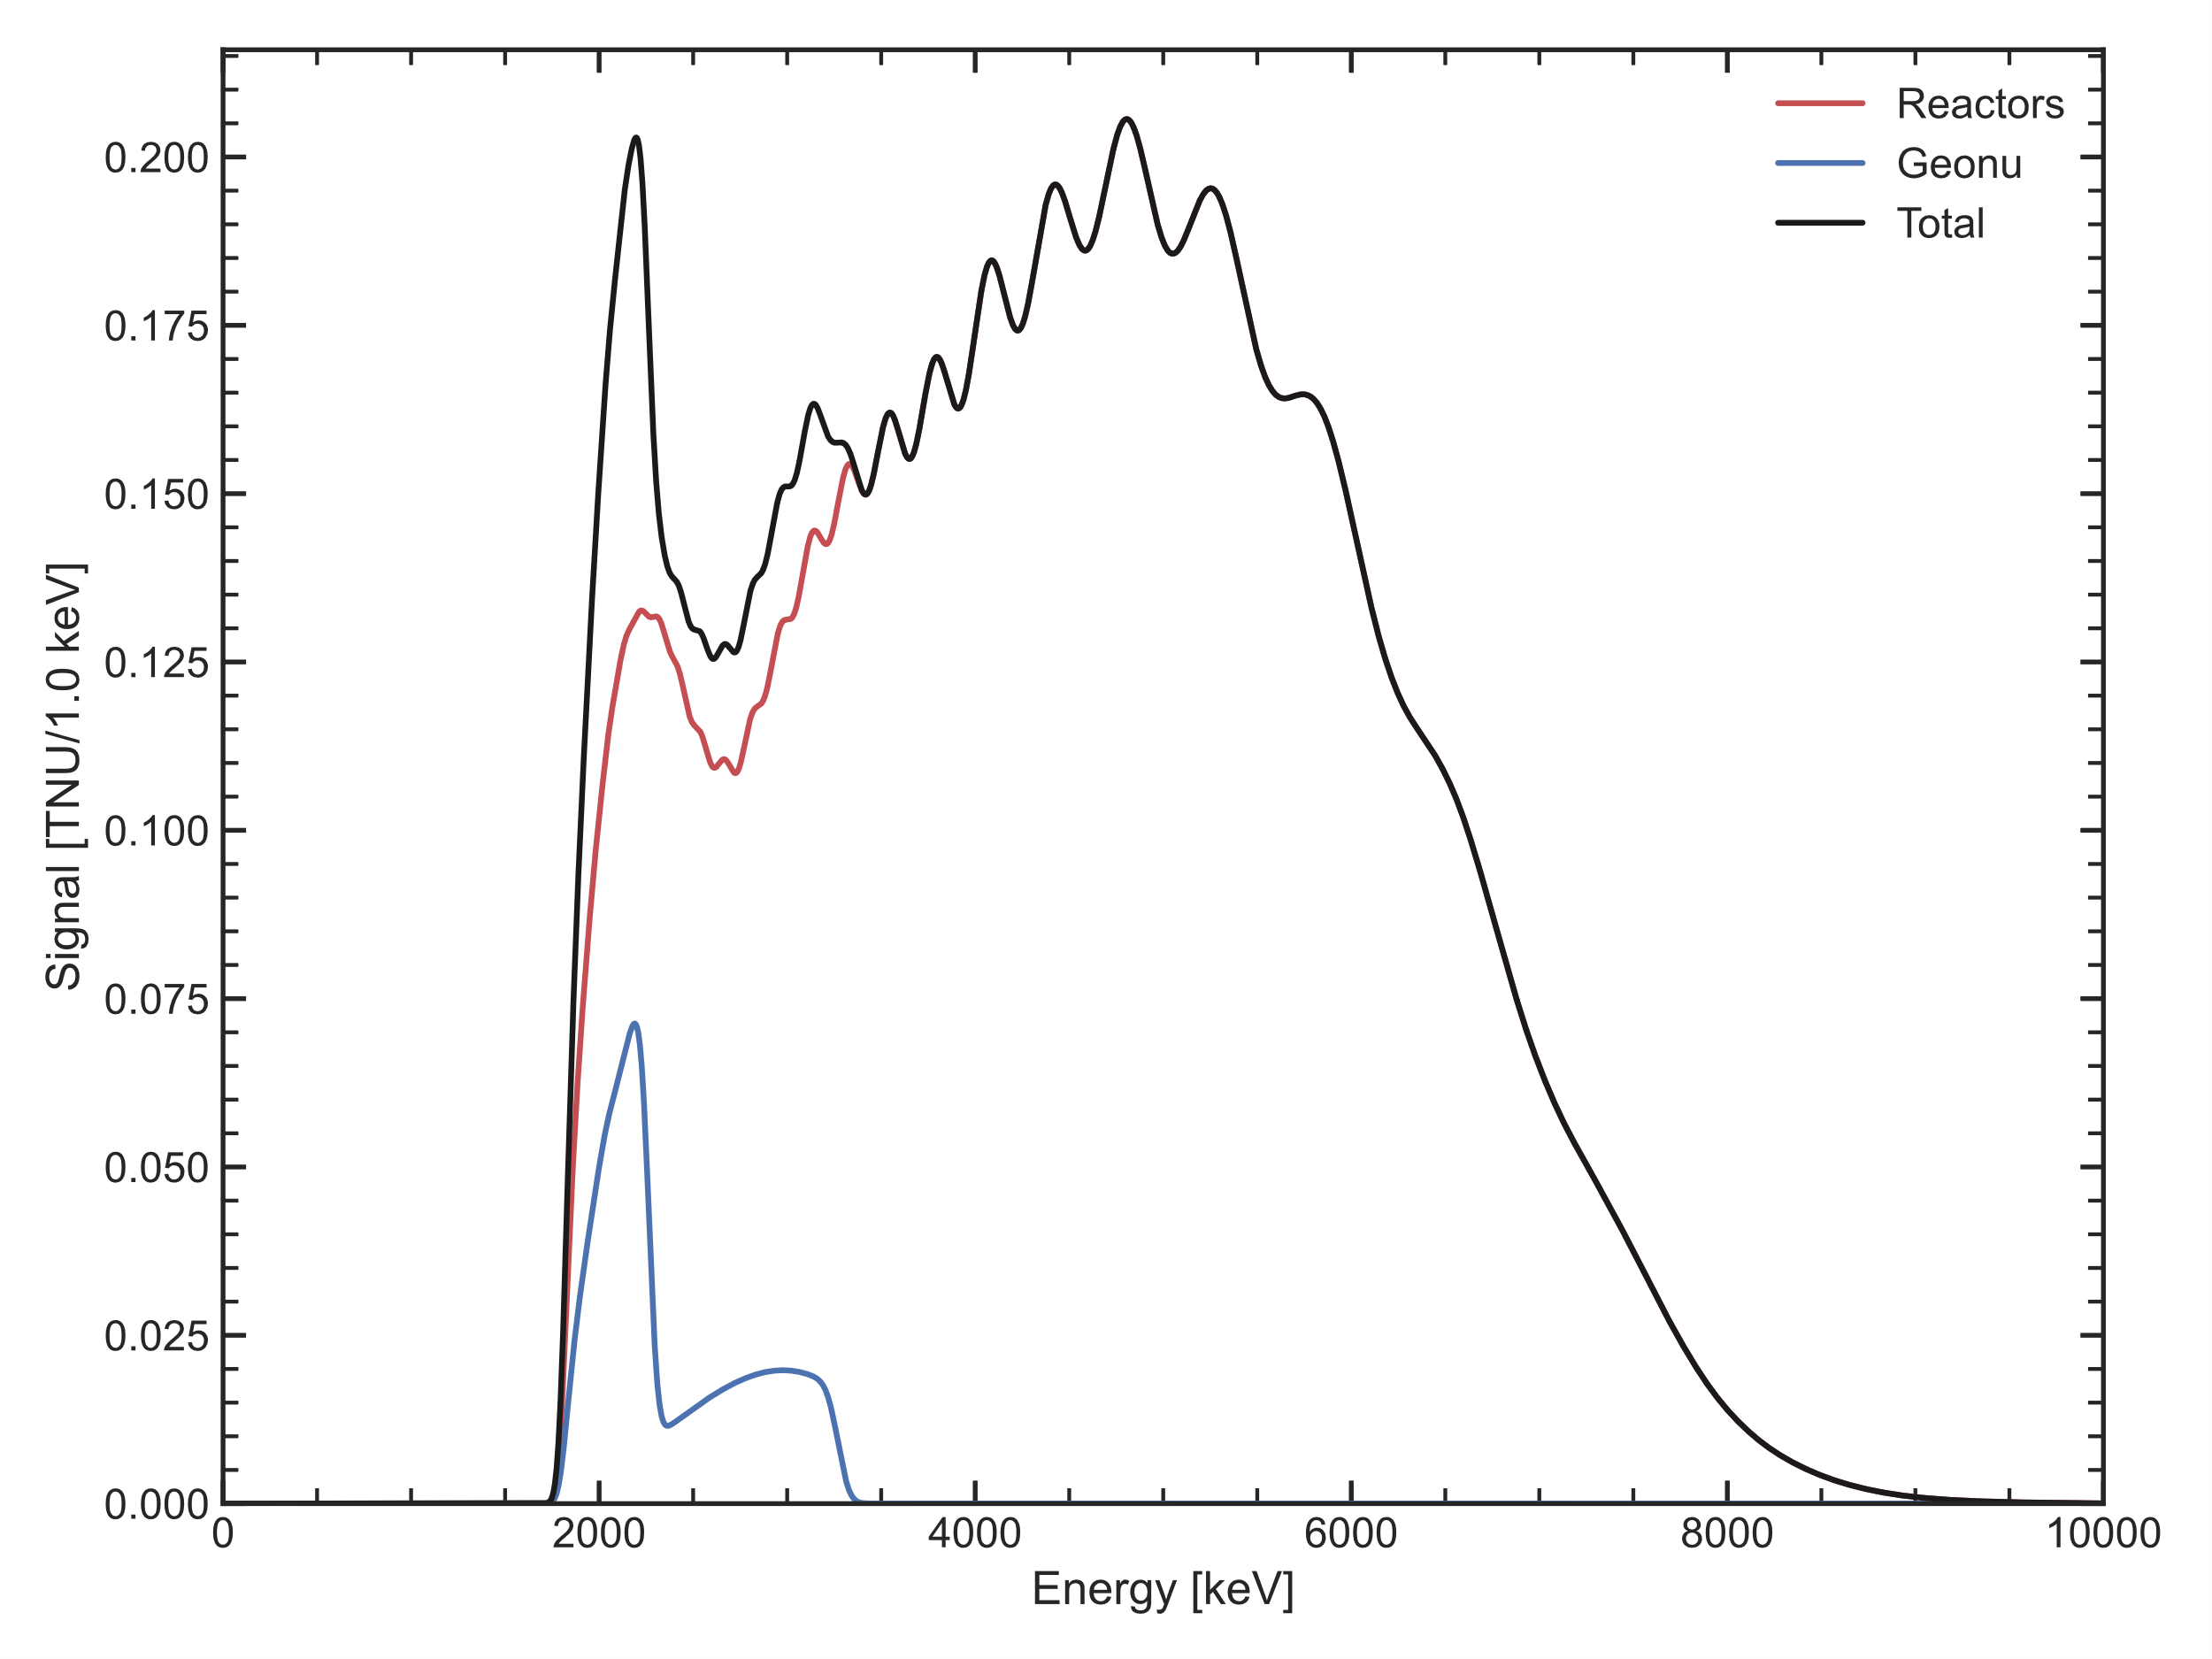
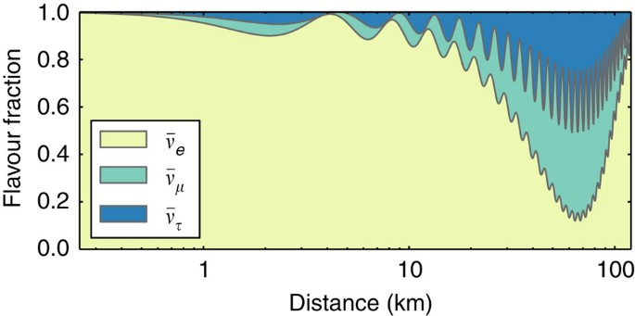
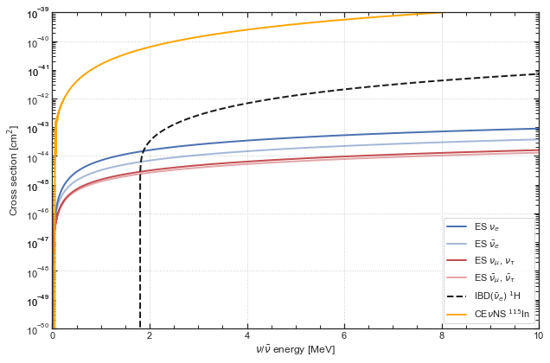
Modeling the antineutrino signal
Production
Propagation
Detection

Slide 4
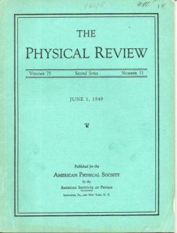

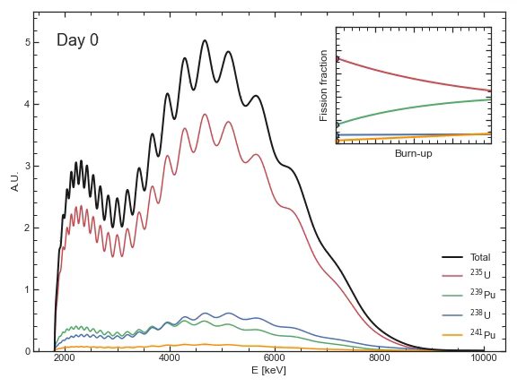
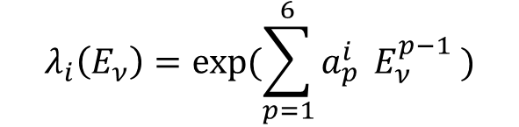
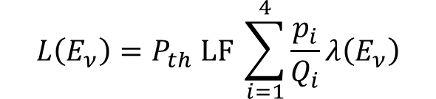
Modeling reactor antineutrinos
Improved predictions of reactor antineutrino spectra Th. A. Mueller et al.
Physical Review C (2011)
$$L\left(E_{ν}\right)=P_{th} LF \sum_{i=1}^{4}{\frac{p_{i}}{Q_{i}}λ\left(E_{ν}\right)}$$
$$λ_{i}\left(E_{ν}\right)=exp(\sum_{p=1}^{6}{a_{p}^{i} }E_{ν}^{p−1} )$$
Reference worldwide model for antineutrinos from reactors M. Baldoncini et al.
Physical Review D (2015)
In reactors, electron antineutrinos are emitted primarily from the fissions of four isotopes: ²³⁵U, ²³⁸U, ²³⁹Pu, and ²⁴¹Pu. Fissions of other isotopes contribute less than 0.3%.
Fissile isotope | Typical p_{i} [%] | Q_{i} [MeV/fission]
²³⁵U | 55% | 202.36 ± 0.26
²³⁸U | 10% | 205.99 ± 0.52
²³⁹Pu | 30% | 211.12 ± 0.34
²⁴¹Pu | 5% | 214.26 ± 0.33

Slide 5
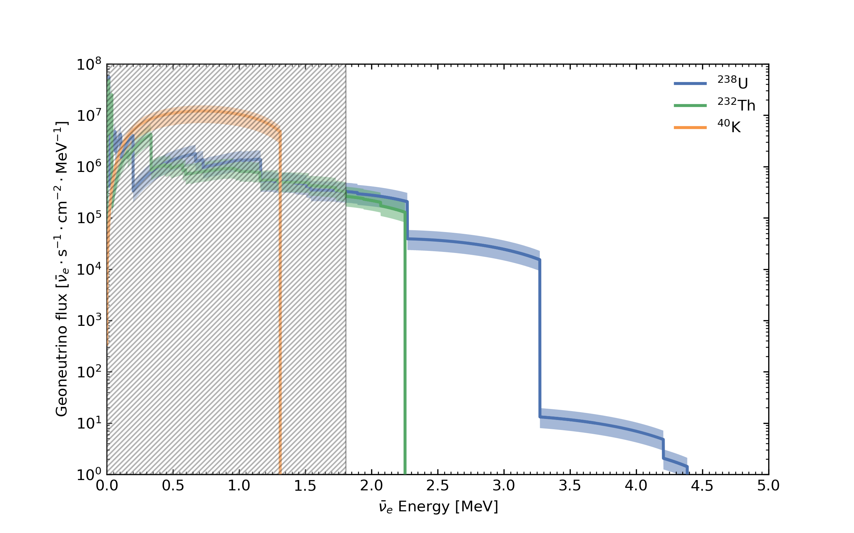
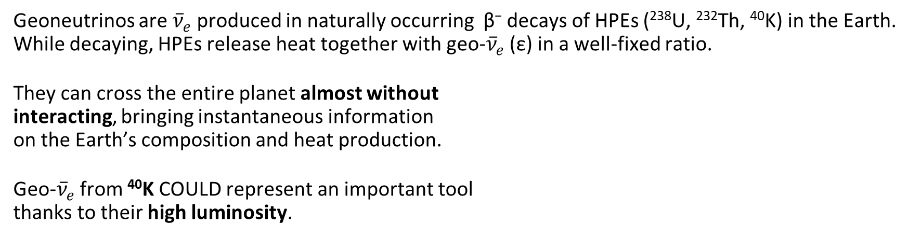
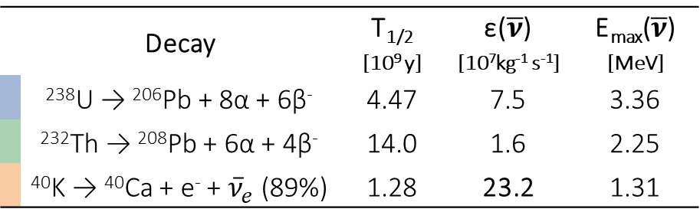
Modeling geoneutrinos
$$Φ′\left(i,\overline{r}\right)={ε′}_{i,\overline{ν}}⋅\int{dE_{\overline{ν}}⋅λ\left(i , E_{\overline{ν}}\right)}\int{d^{3}r^{′}⋅P_{ee}\left(\left|\overline{r}−{\overline{r}}^{′}\right|, E_{\overline{ν}}\right)⋅\frac{a\left(i, {\overline{r}}^{′}\right)⋅ρ\left({\overline{r}}^{′}\right)}{4π{\left|\overline{r}−{\overline{r}}^{′}\right|}^{2}}}$$
Geoneutrinos are ${\overline{ν}}_{e}$ produced in naturally occurring β⁻ decays of HPEs (²³⁸U, ²³²Th, ⁴⁰K) in the Earth. While decaying, HPEs release heat together with geo-${\overline{ν}}_{e}$ (ε) in a well-fixed ratio.
They can cross the entire planet almost without interacting, bringing instantaneous information on the Earth’s composition and heat production.
Geo-${\overline{ν}}_{e}$ from ⁴⁰K COULD represent an important tool thanks to their high luminosity.
 | Decay | T_{1/2} [10⁹ y] | ε($\overline{ν}$) [10⁷kg⁻¹ s⁻¹] | E_{max}($\overline{ν}$) [MeV]
 | ²³⁸U → ²⁰⁶Pb + 8α + 6β⁻ | 4.47 | 7.5 | 3.36
 | ²³²Th → ²⁰⁸Pb + 6α + 4β⁻ | 14.0 | 1.6 | 2.25
 | ⁴⁰K → ⁴⁰Ca + e⁻ + ${\overline{ν}}_{e}$ (89%) | 1.28 | 23.2 | 1.31

Slide 6
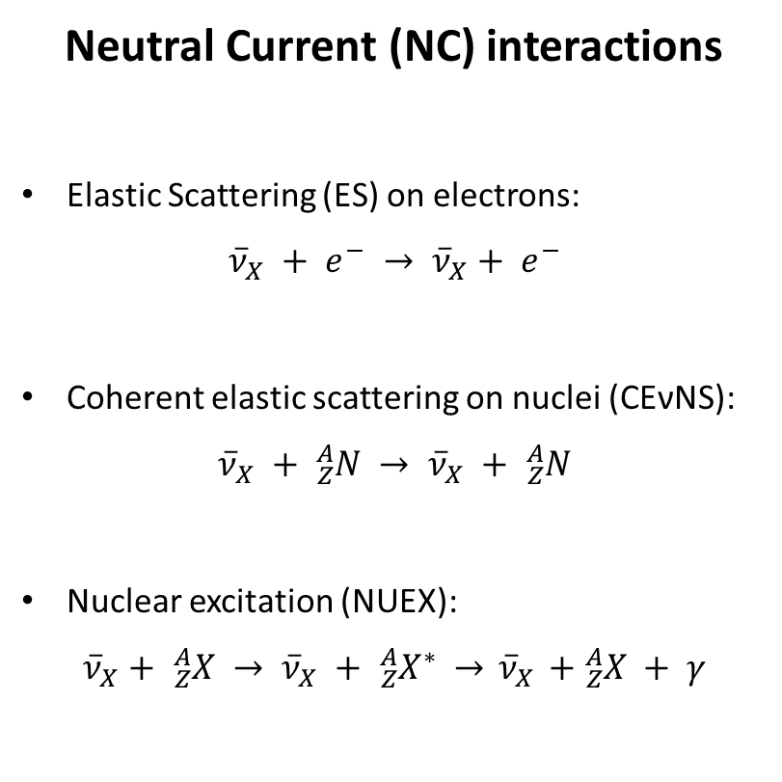
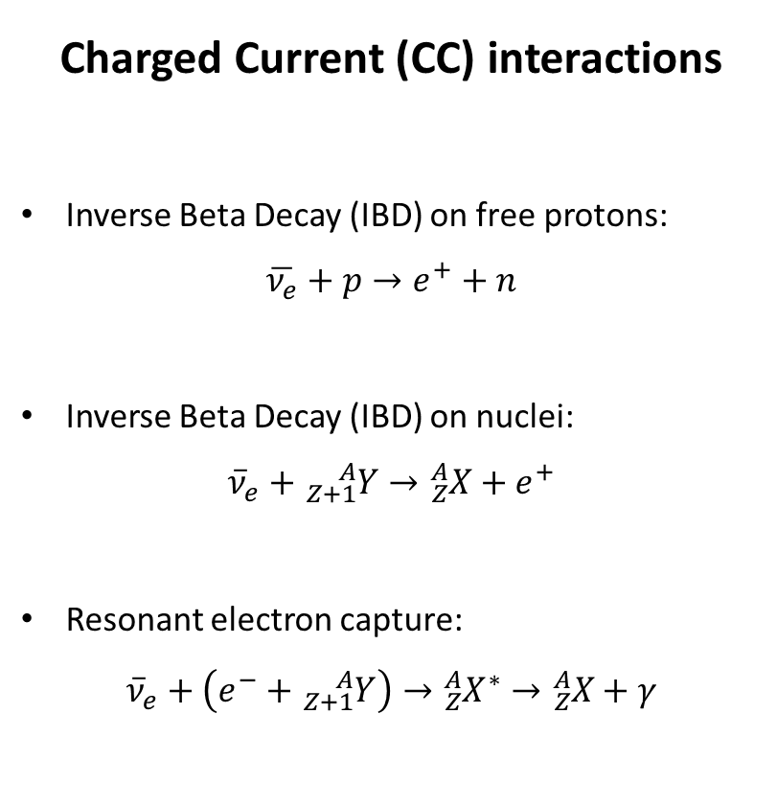
Possible antineutrino interactions
Neutral Current (NC) interactions
Elastic Scattering (ES) on electrons: ${\overline{ν}}_{X} + e^{−} → {\overline{ν}}_{X}+ e^{−}$
Coherent elastic scattering on nuclei (CEνNS): ${\overline{ν}}_{X} + {}_{Z}^{A}N → {\overline{ν}}_{X} + {}_{Z}^{A}N$
Nuclear excitation (NUEX): ${\overline{ν}}_{X}+ {}_{Z}^{A}X → {\overline{ν}}_{X} + {}_{Z}^{A}{X^{∗}} →{ \overline{ν}}_{X} + {}_{Z}^{A}X + γ$
Charged Current (CC) interactions
Inverse Beta Decay (IBD) on free protons: $\overline{ν_{e}}+p→e^{+}+n$
Inverse Beta Decay (IBD) on nuclei: ${\overline{ν}}_{e}+{}_{Z+1}^{A}Y→{}_{Z}^{A}X+e^{+}$
Resonant electron capture: ${\overline{ν}}_{e}+\left(e^{−}+{}_{Z+1}^{A}Y\right)→{}_{Z}^{A}{X^{∗}}→{}_{Z}^{A}X+γ$

Slide 7
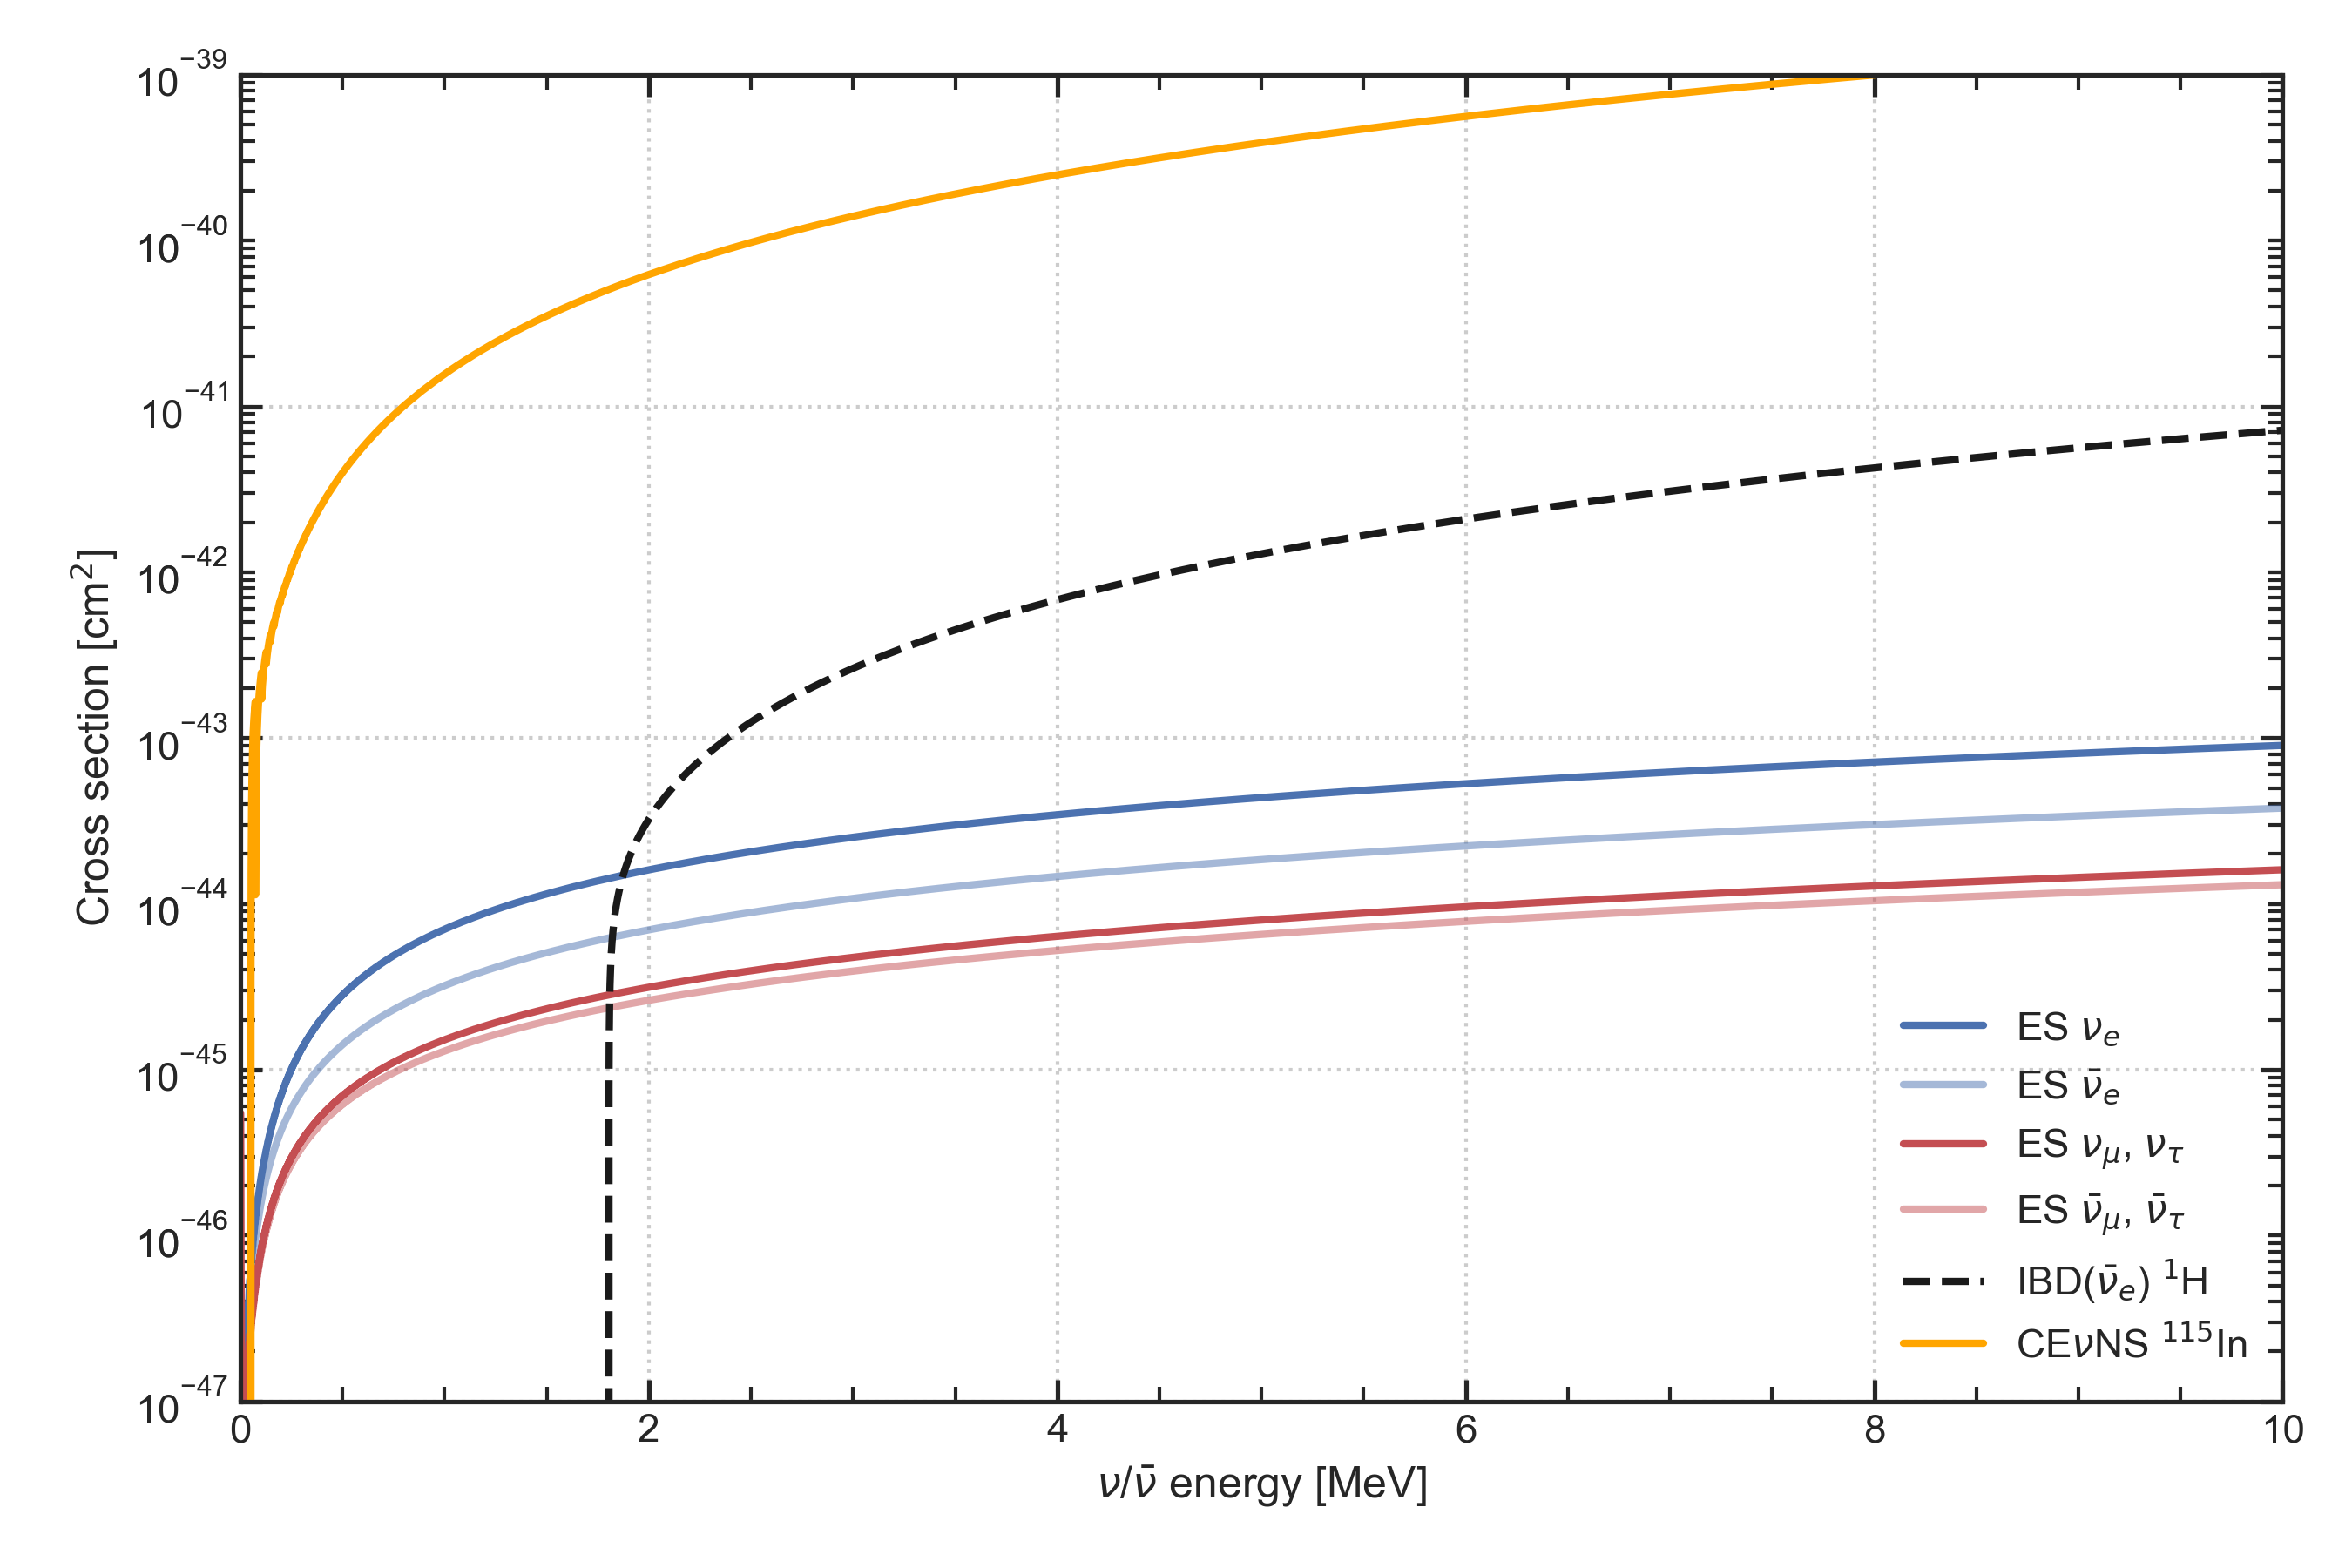
Some possible interactions representing a background
Inverse Beta Decay (IBD)
The currently employed reaction has an energy threshold at 1.8 MeV. Its current detection relies on a double coincidence rejecting most backgrounds.
Elastic Scattering on electrons (ES)
It has no energy threshold (apart from our capability to detect electron recoil). It does not allow to distinguish flavors, or to separate neutrinos from antineutrinos (in the absence of directional information).
Coherent neutrino-nucleus scattering (CEνNS)
It has no energy threshold (apart from our capability to detect nuclear recoil… which is almost always too small). It does not allow to distinguish flavors, or to separate neutrinos from antineutrinos

Slide 8
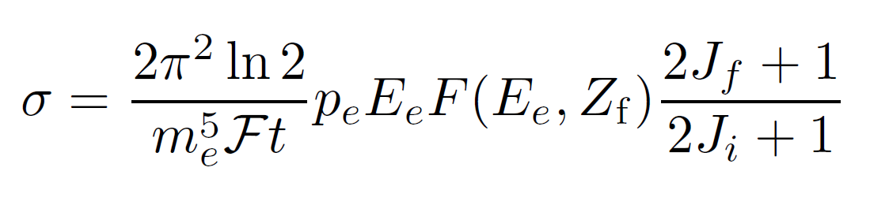
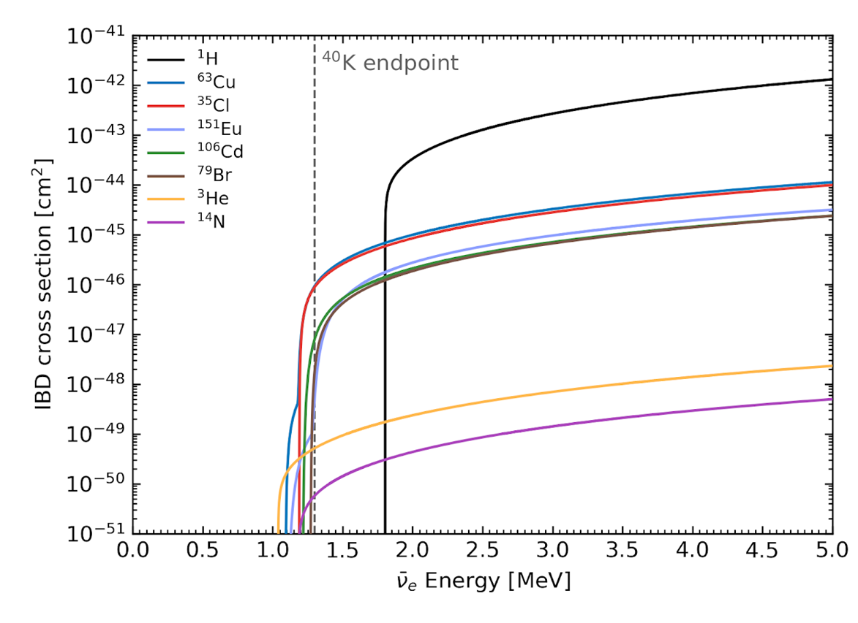

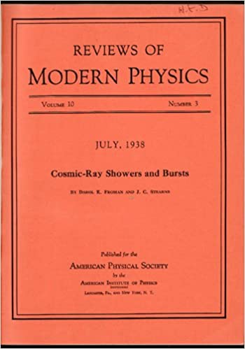
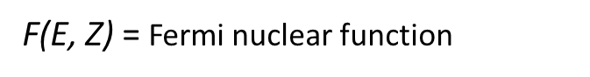
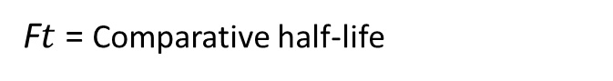
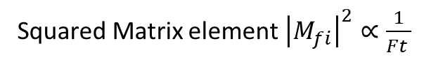
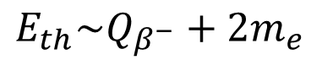
Inverse Beta Decay (IBD)
F$t$= Comparative half-life
Squared Matrix element${\left|M_{fi}\right|}^{2}∝\frac{1}{Ft }$
F(E, Z) = Fermi nuclear function
$$E_{th}\sim Q_{β^{−}}+2m_{e}$$
Precise quasielastic neutrino/nucleon cross section A. Strumia and F. Vissani
Physics Letters B (2003)
Weighted
From eV to EeV: Neutrino Cross-Sections Across Energy Scales
J. A. Formaggio and G. P. Zeller
Reviews of Modern Physics (2012)

Slide 9
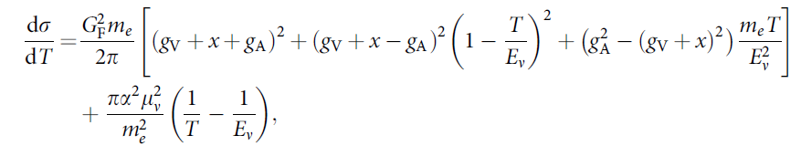
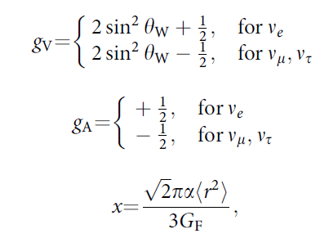
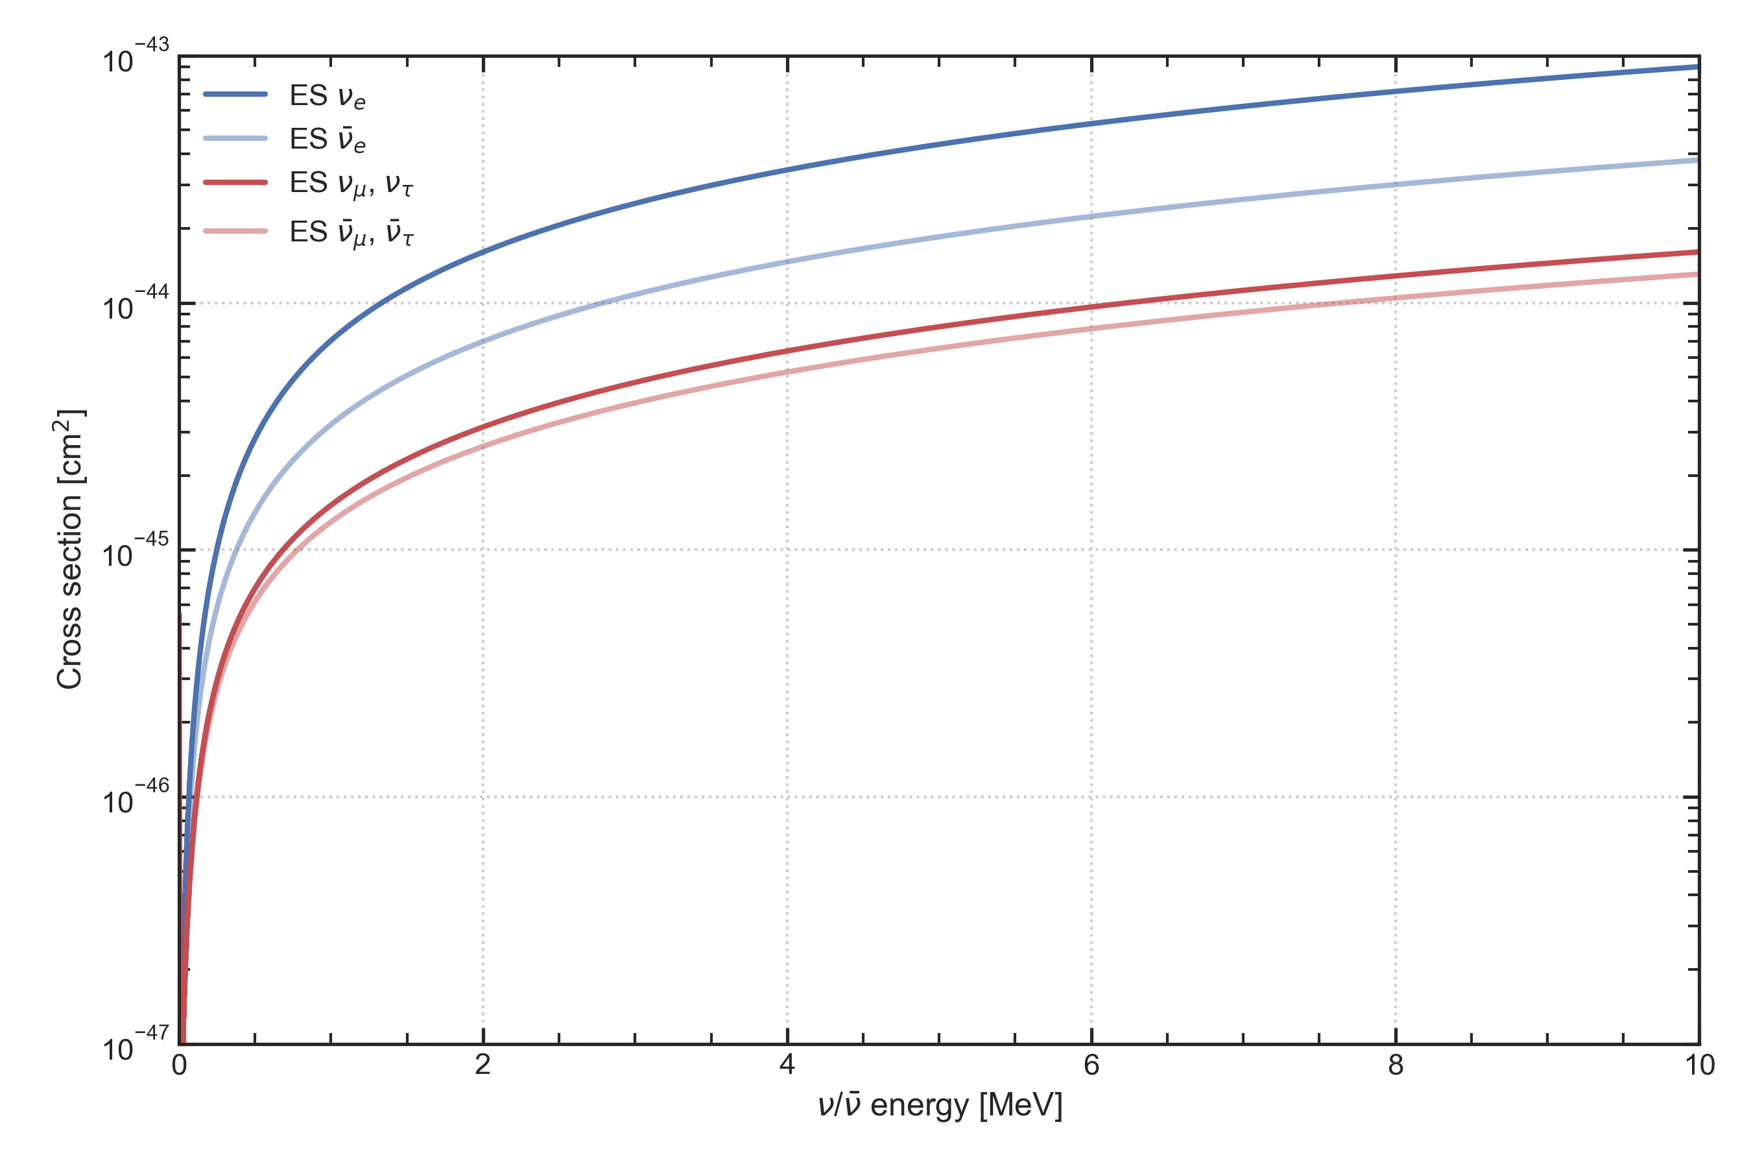
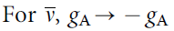
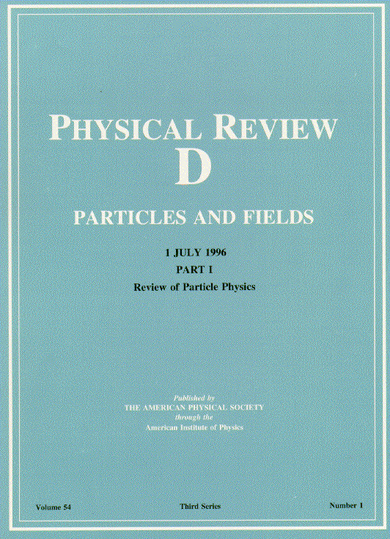

Elastic Scattering (ES) on electrons
Dependence on minimum detectable recoil kinetic energy of target electron
Dependence on antineutrino flavor
Matter/antimatter dependence
Neutrino electromagnetic form factors P. Vogel and J. Engel
Physical Review D (1989)
Exploring the hidden interior of the Earth with directional neutrino measurements M. Leyton, S. Dye, J. Monroe
Nature Communications (2017)

Slide 10
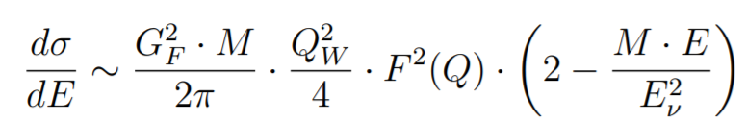
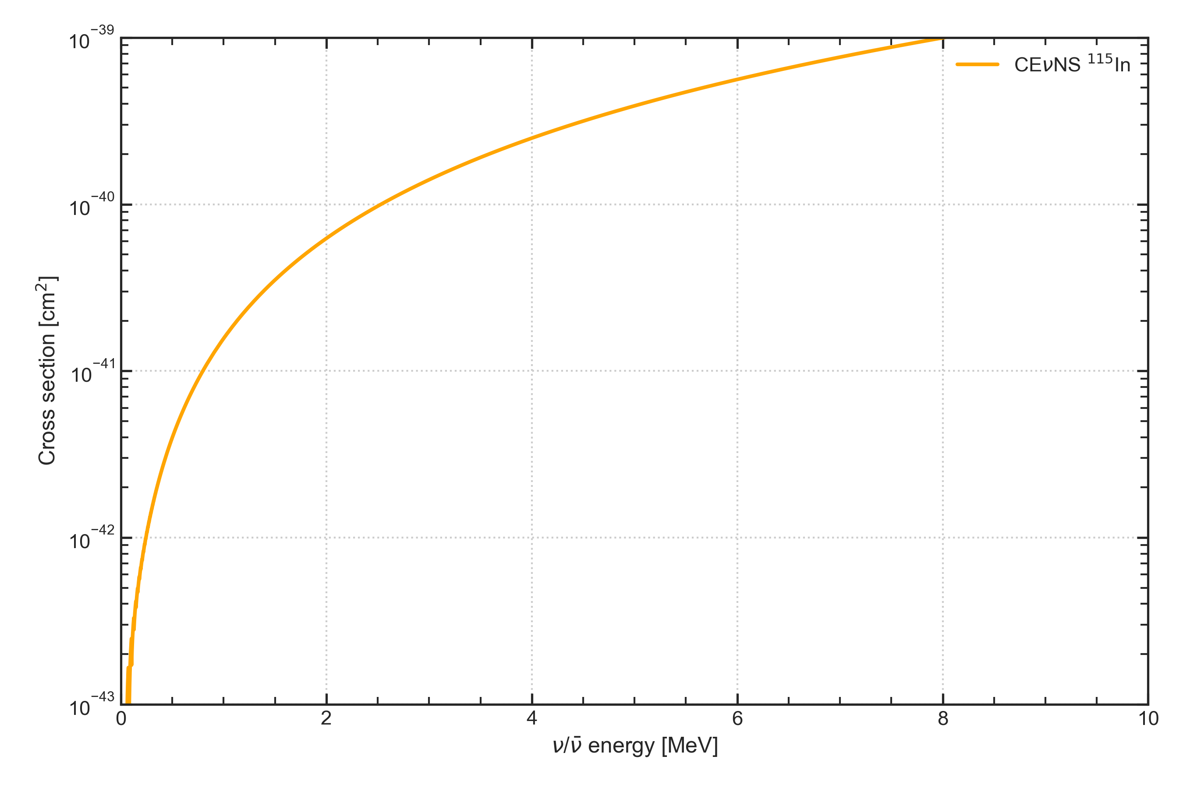
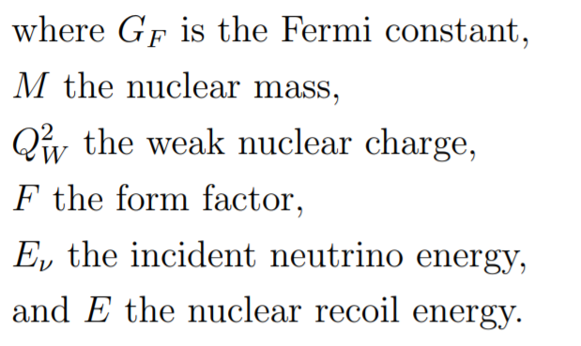
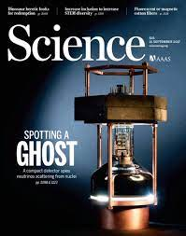

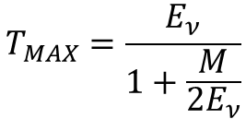
Coherent neutrino-nucleus scattering (CEνNS)
Dependence on minimum detectable recoil kinetic energy of target nucleus
Impractical to detect
$$T_{MAX}=\frac{E_{ν}}{1+\frac{M}{2E_{ν}}}$$
Observation of coherent elastic neutrino-nucleus scattering
D. Akimov et al.
Science (2017)
Coherent elastic neutrino-nucleus scattering at the
European Spallation Source D. Baxter et al.
Journal of High Energy Physics (2020)

Slide 11
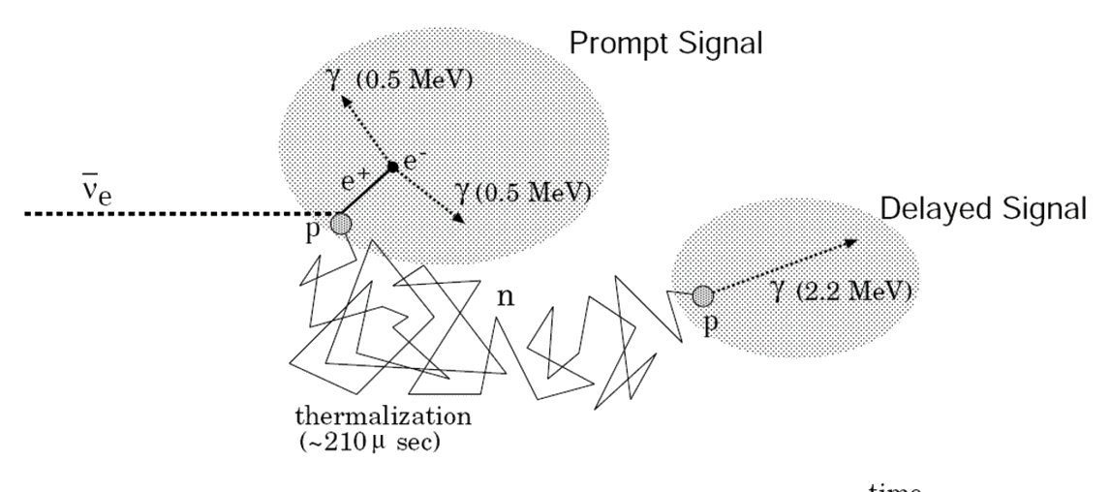
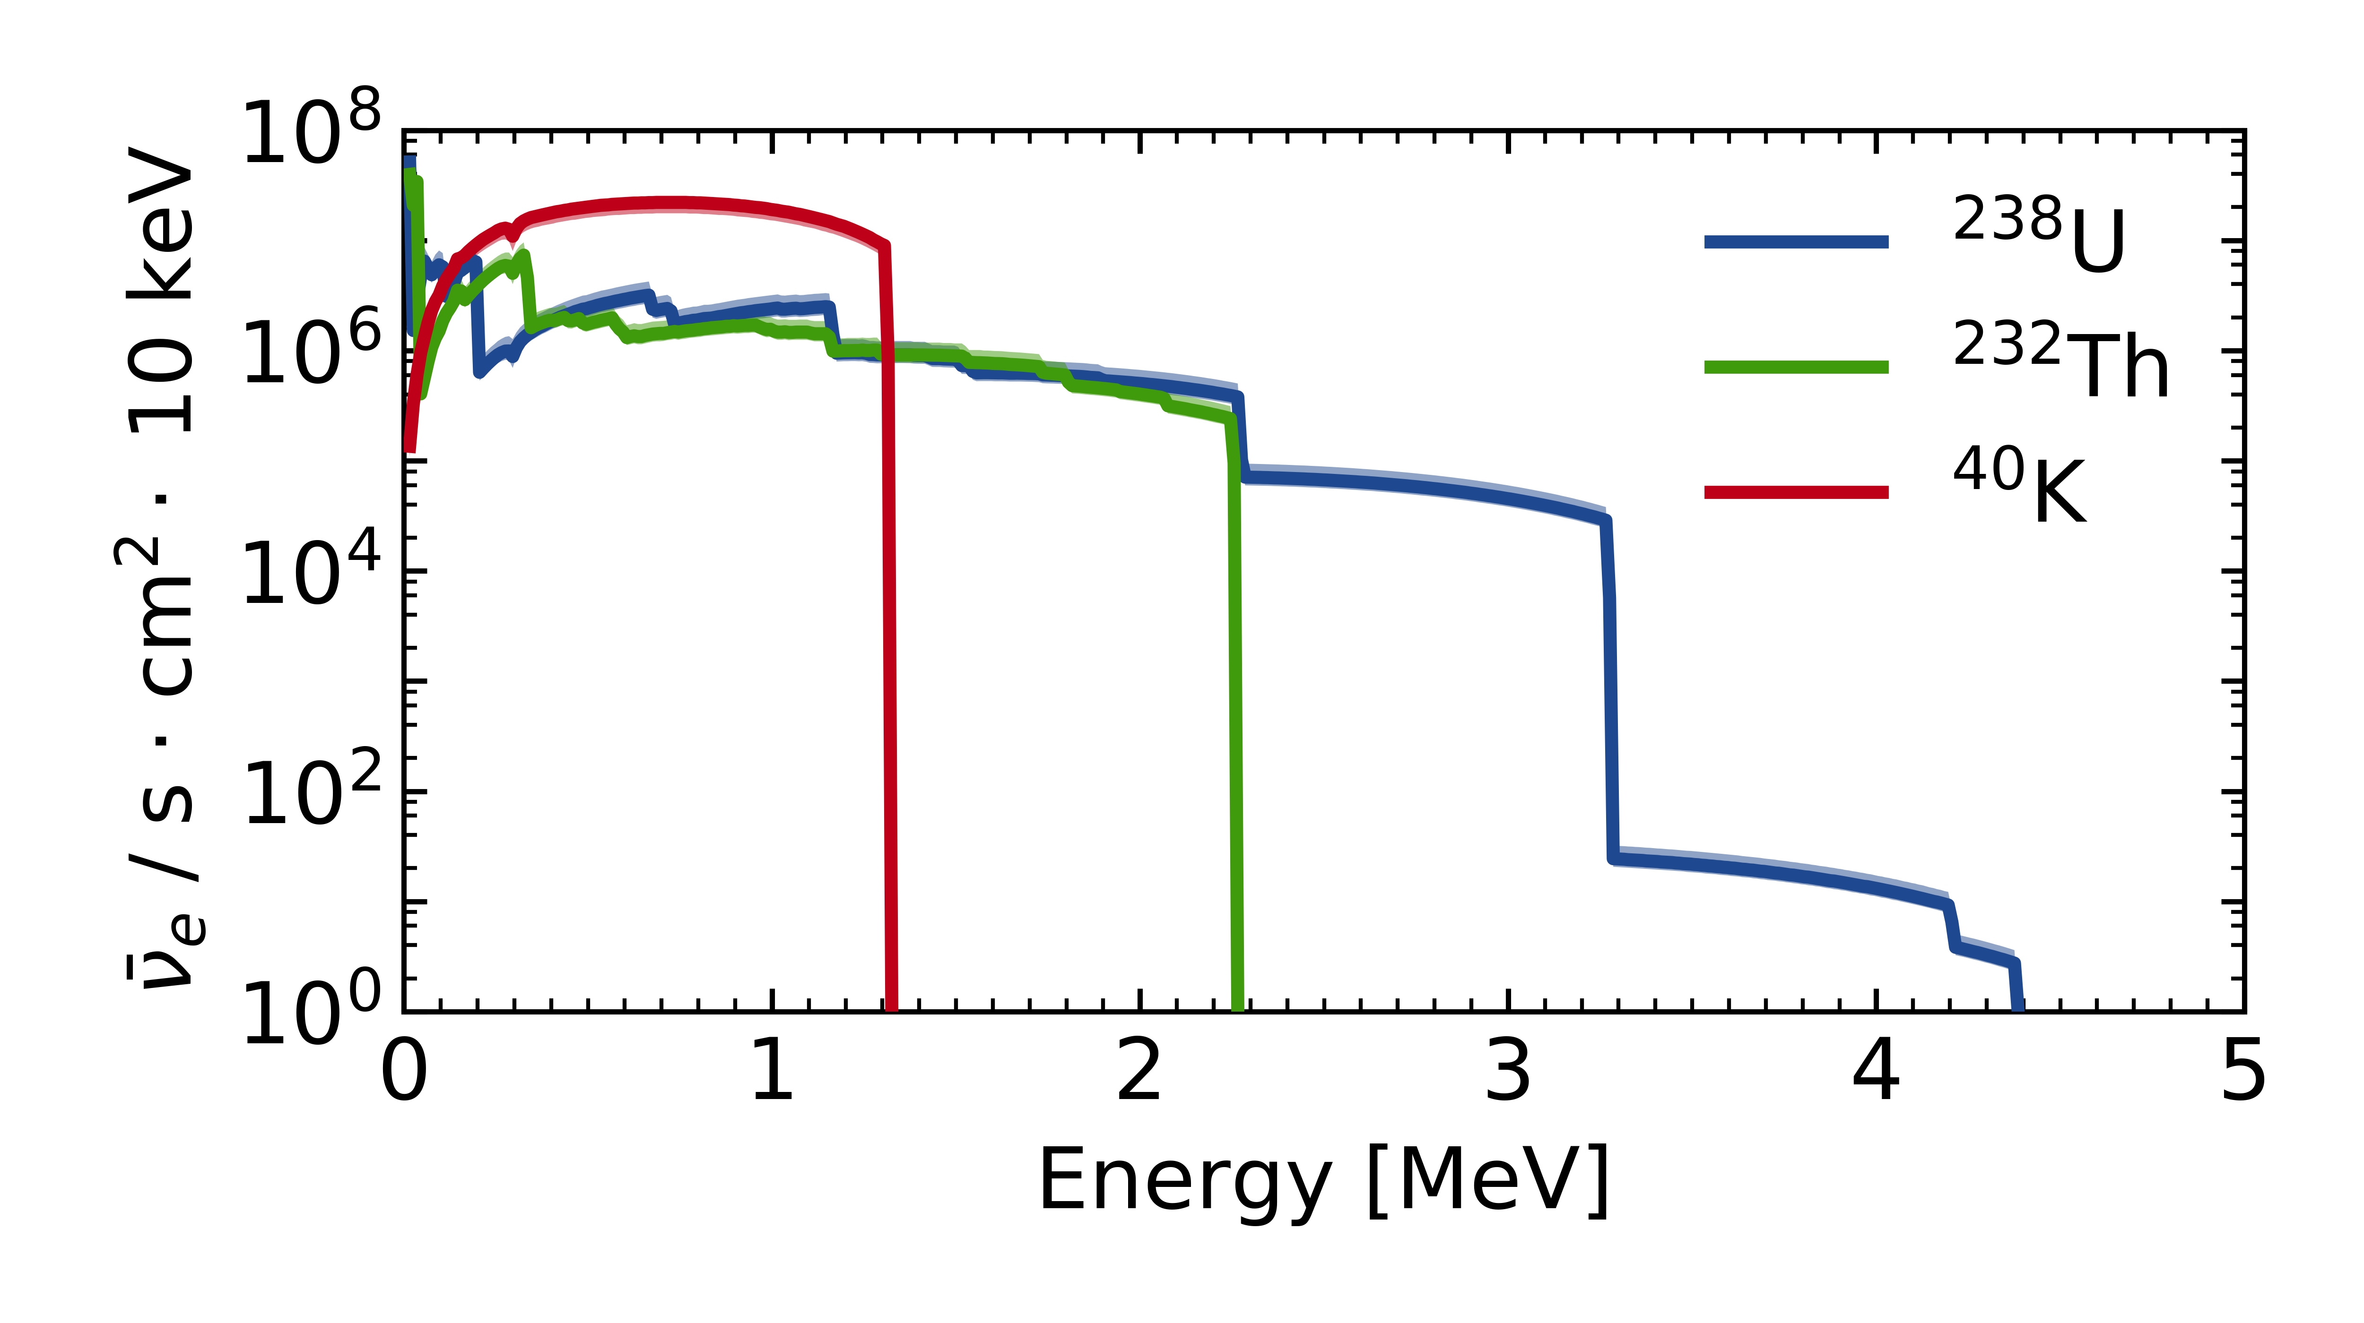
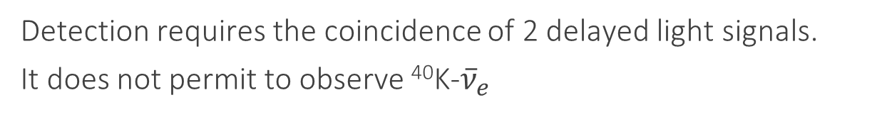
Inverse Beta Decay (IBD) detection
Geoneutrinos are detected by IBD in ~kton Liquid Scintillation Detectors.
${\overline{ν}}_{e}+p→n+e^{+}−$ 1.806 MeV
Detection requires the coincidence of 2 delayed light signals.
It does not permit to observe ⁴⁰K-${\overline{ν}}_{e}$
E_{th}

Slide 12

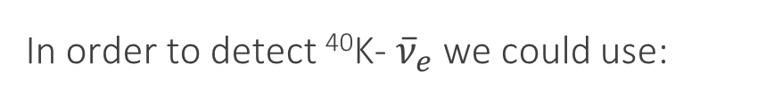
Inverse Beta Decay (IBD) detection
Geoneutrinos are detected by IBD in ~kton Liquid Scintillation Detectors.
${\overline{ν}}_{e}+p→n+e^{+}−$ 1.806 MeV
Detection requires the coincidence of 2 delayed light signals.
It does not permit to observe ⁴⁰K-${\overline{ν}}_{e}$
Impossible to tag in current Liquid Scintillator Detector
In order to detect ⁴⁰K- ${\overline{ν}}_{e}$we could use:
E_{th}
${\overline{ν}}_{e}+{}_{Z+1}^{A}Y→{}_{Z}^{A}X+e^{+}−$ E_{th}
We shall require:
E_{th} < 1.3 MeV
High cross-section
High Y natural isotopic abundance

Slide 13
IBD target isotopes for ⁴⁰K detection
Data from ENSDF database
Isotopic abundance [%]
99.99
1.34 ∙ 10⁻⁴
99.64
75.76
69.15
50.69
1.25
47.81
E_{th} [MeV]
1.806
1.041
1.178
1.189
1.089
1.176
1.173
1.268
1.212
1.099
1.266
Log ft
3.0
3.1
9.0
5.0
6.7
5.0
10.8
5.0
4.1
7.5
5.0
Target process | Isotopic abundance [%] | E_{th} [MeV] | Log ft
¹H → ¹n | 99.99 | 1.806 | 3.0
³He → ³H | 1.34 ∙ 10⁻⁴ | 1.041 | 3.1
¹⁴N → ¹⁴C | 99.64 | 1.178 | 9.0
³⁵Cl → ³⁵S | 75.76 | 1.189 | 5.0
⁶³Cu → ⁶³Ni | 69.15 | 1.089 | 6.7
⁶³Cu → ⁶³Ni* |  | 1.176 | 5.0
⁷⁹Br → ⁷⁹Se | 50.69 | 1.173 | 10.8
⁷⁹Br → ⁷⁹Se* |  | 1.268 | 5.0
¹⁰⁶Cd → ¹⁰⁶Ag | 1.25 | 1.212 | 4.1
¹⁵¹Eu → ¹⁵¹Sm | 47.81 | 1.099 | 7.5
¹⁵¹Eu → ¹⁵¹Sm* |  | 1.266 | 5.0

Slide 14
Geoneutrino expected signals at LNGS
Target process | S(U) [TNU] | S(Th) [TNU] | S(K) [TNU]
¹H → ¹n | 31.5 [24.0 ; 47.0] | 9.0 [6.4 ; 14.1] | /
⁶³Cu → ⁶³Ni⁽*⁾ | 0.85 [0.64 ; 1.26] | 0.49 [0.35 ; 0.77] | 0.10 [0.07 ; 0.13]
³⁵Cl → ³⁵S | 0.73 [0.56 ; 1.09] | 0.43 [0.30 ; 0.67] | 0.10 [0.07 ; 0.13]
¹⁵¹Eu → ¹⁵¹Sm⁽*⁾ | 0.22 [0.17 ; 0.33] | 0.12 [0.08 ; 0.18] | (3.2 [2.3 ; 4.2]) ∙ 10⁻⁴
⁷⁹Br → ⁷⁹Se⁽*⁾ | 0.15 [0.12 ; 0.23] | (8.3 [5.9 ; 13.0]) ∙ 10⁻² | (6.5 [4.7 ; 8.4]) ∙ 10⁻⁴
¹⁰⁶Cd → ¹⁰⁶Ag | (1.7 [1.3 ; 2.6]) ∙ 10⁻¹ | (9.7 [6.9 ; 15.2]) ∙ 10⁻² | (5.1 [3.7 – 6.6]) ∙ 10⁻³
³He → ³H | (2.2 [1.7 ; 3.4]) ∙ 10⁻⁴ | (1.4 [1.0 ; 2.2]) ∙ 10⁻⁴ | (1.7 [1.2 ; 2.1]) ∙ 10⁻⁴
¹⁴N → ¹⁴C | (3.8 [2.9 ; 5.7]) ∙ 10⁻⁵ | (2.3 [1.6 ; 3.5]) ∙ 10⁻⁵ | (8.0 [5.8 ; 10.3]) ∙ 10⁻⁶

Slide 15
Condividiamo!!!

Slide 16
Back up

Slide 17
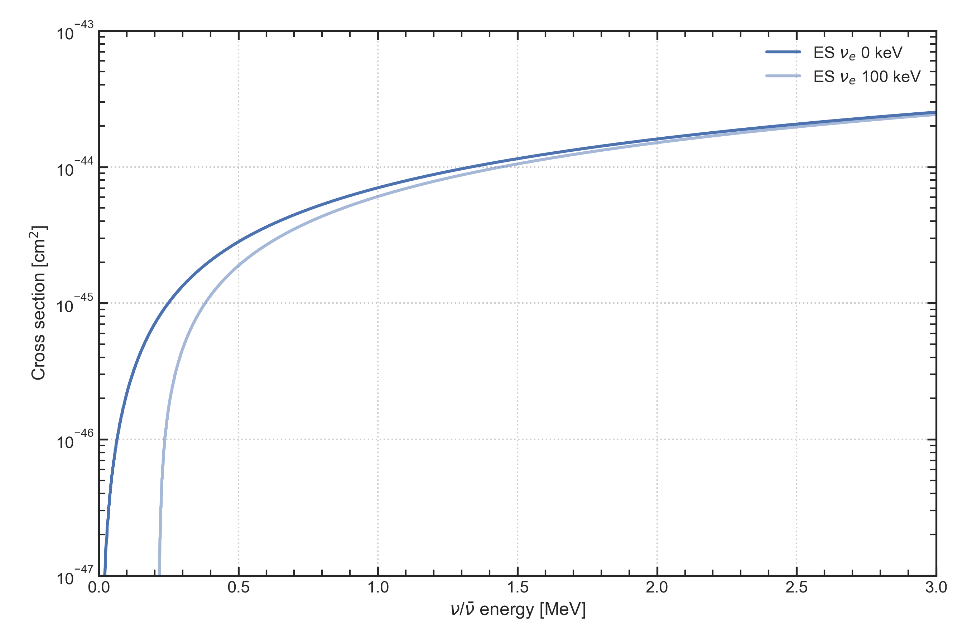
Effect of energy threshold on ES

Slide 18
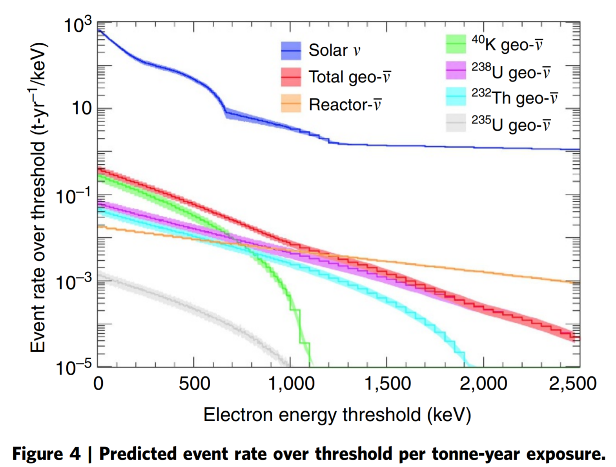
Elastic Scattering on electrons
Exploring the hidden interior of the Earth with directional neutrino measurements M. Leyton, S. Dye, J. Monroe
Nature Communications (2017)

Slide 19
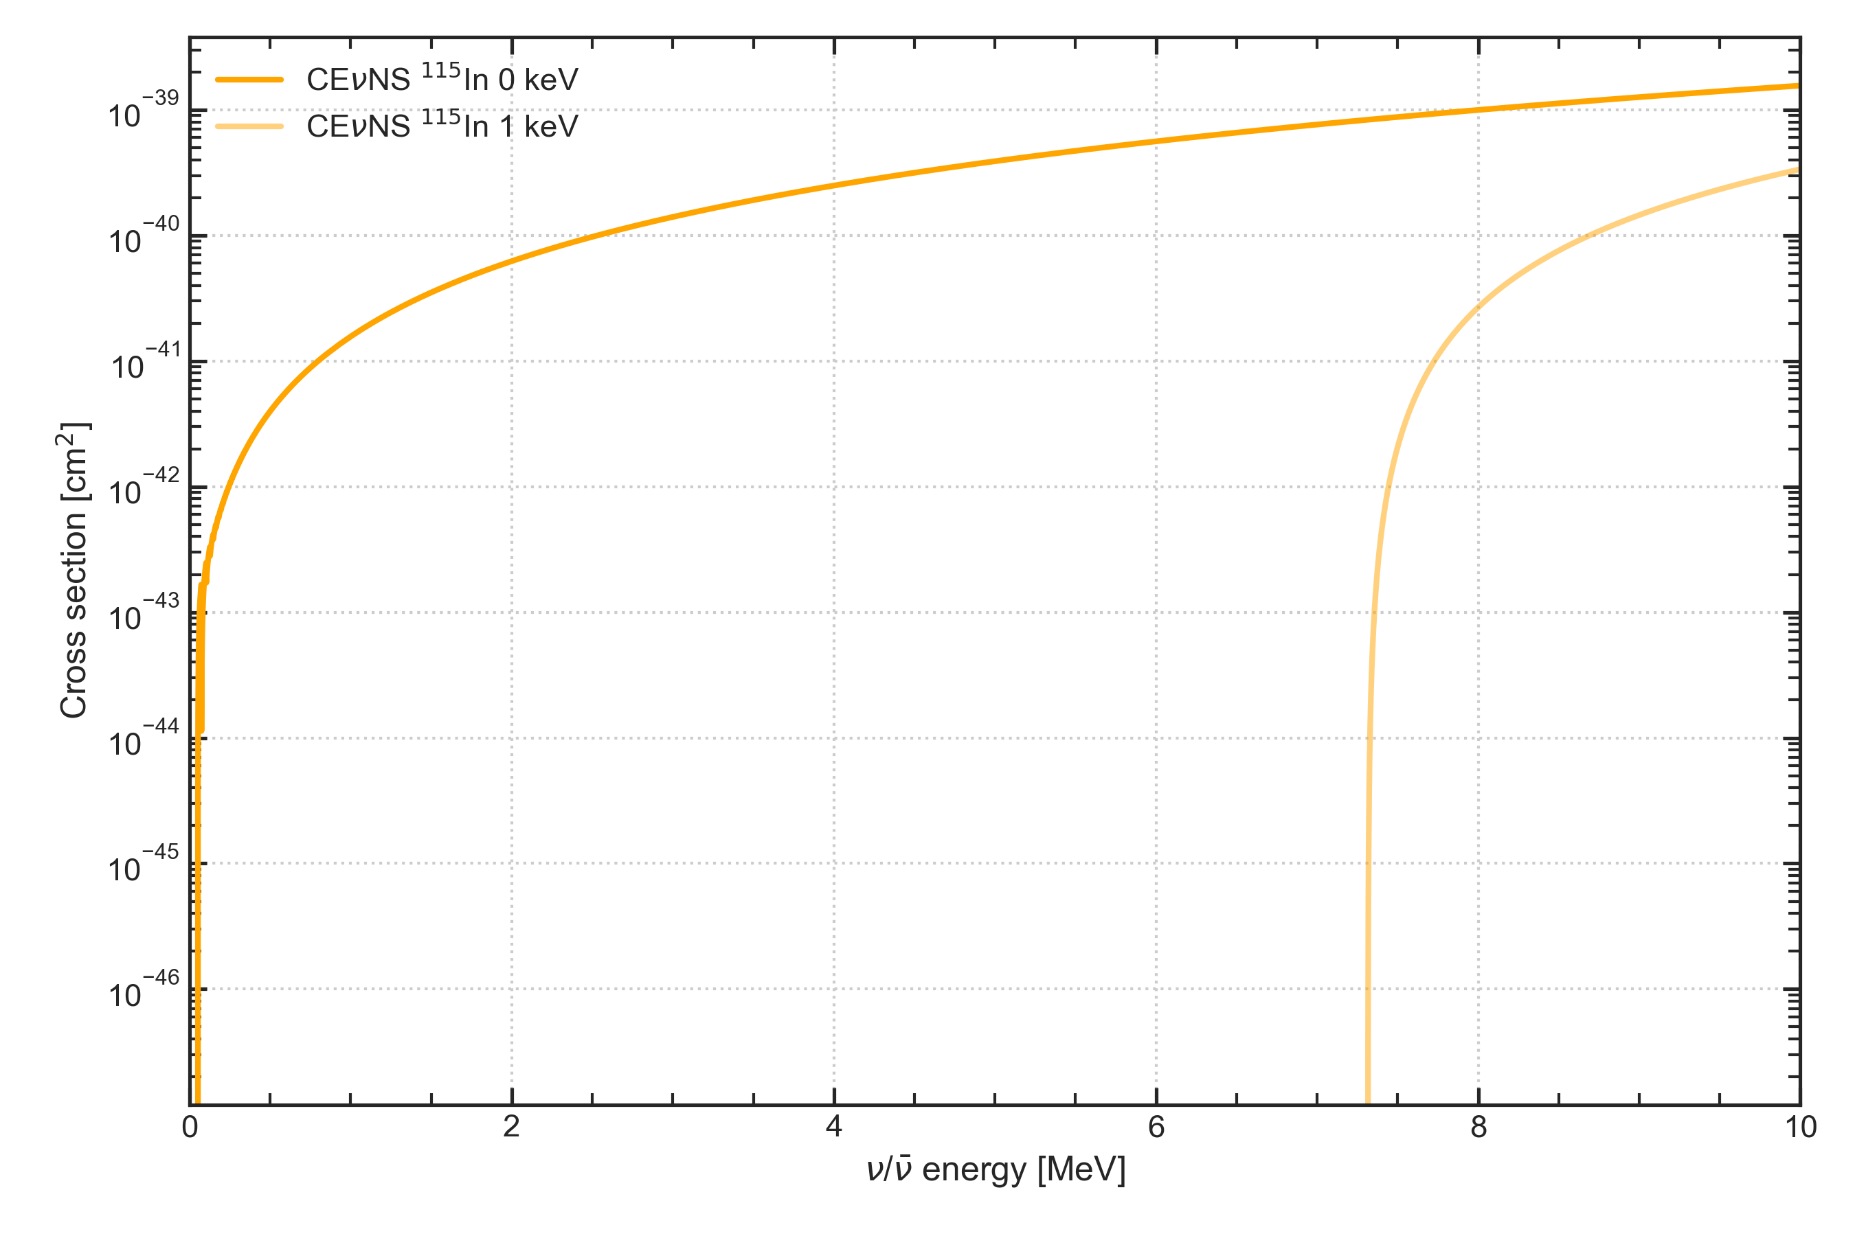
Effect of energy threshold on CEνNS

Slide 20
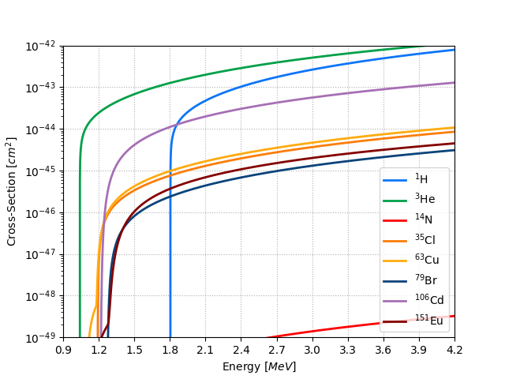
IBD cross-sections on single target isotopes
⁴⁰K endpoint

Slide 21
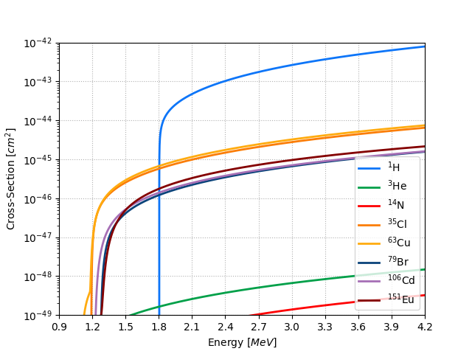
IBD cross-sections weighted with isotopic abundance
⁴⁰K endpoint
³He, which seemed the perfect candidate, is disfavored by its abundance
³⁵Cl has both a low threshold and a good weighted cross-section
⁶³Cu seems to be as promising as ³⁵Cl, but not equally reliable (ft not experimentally measured)

Slide 22
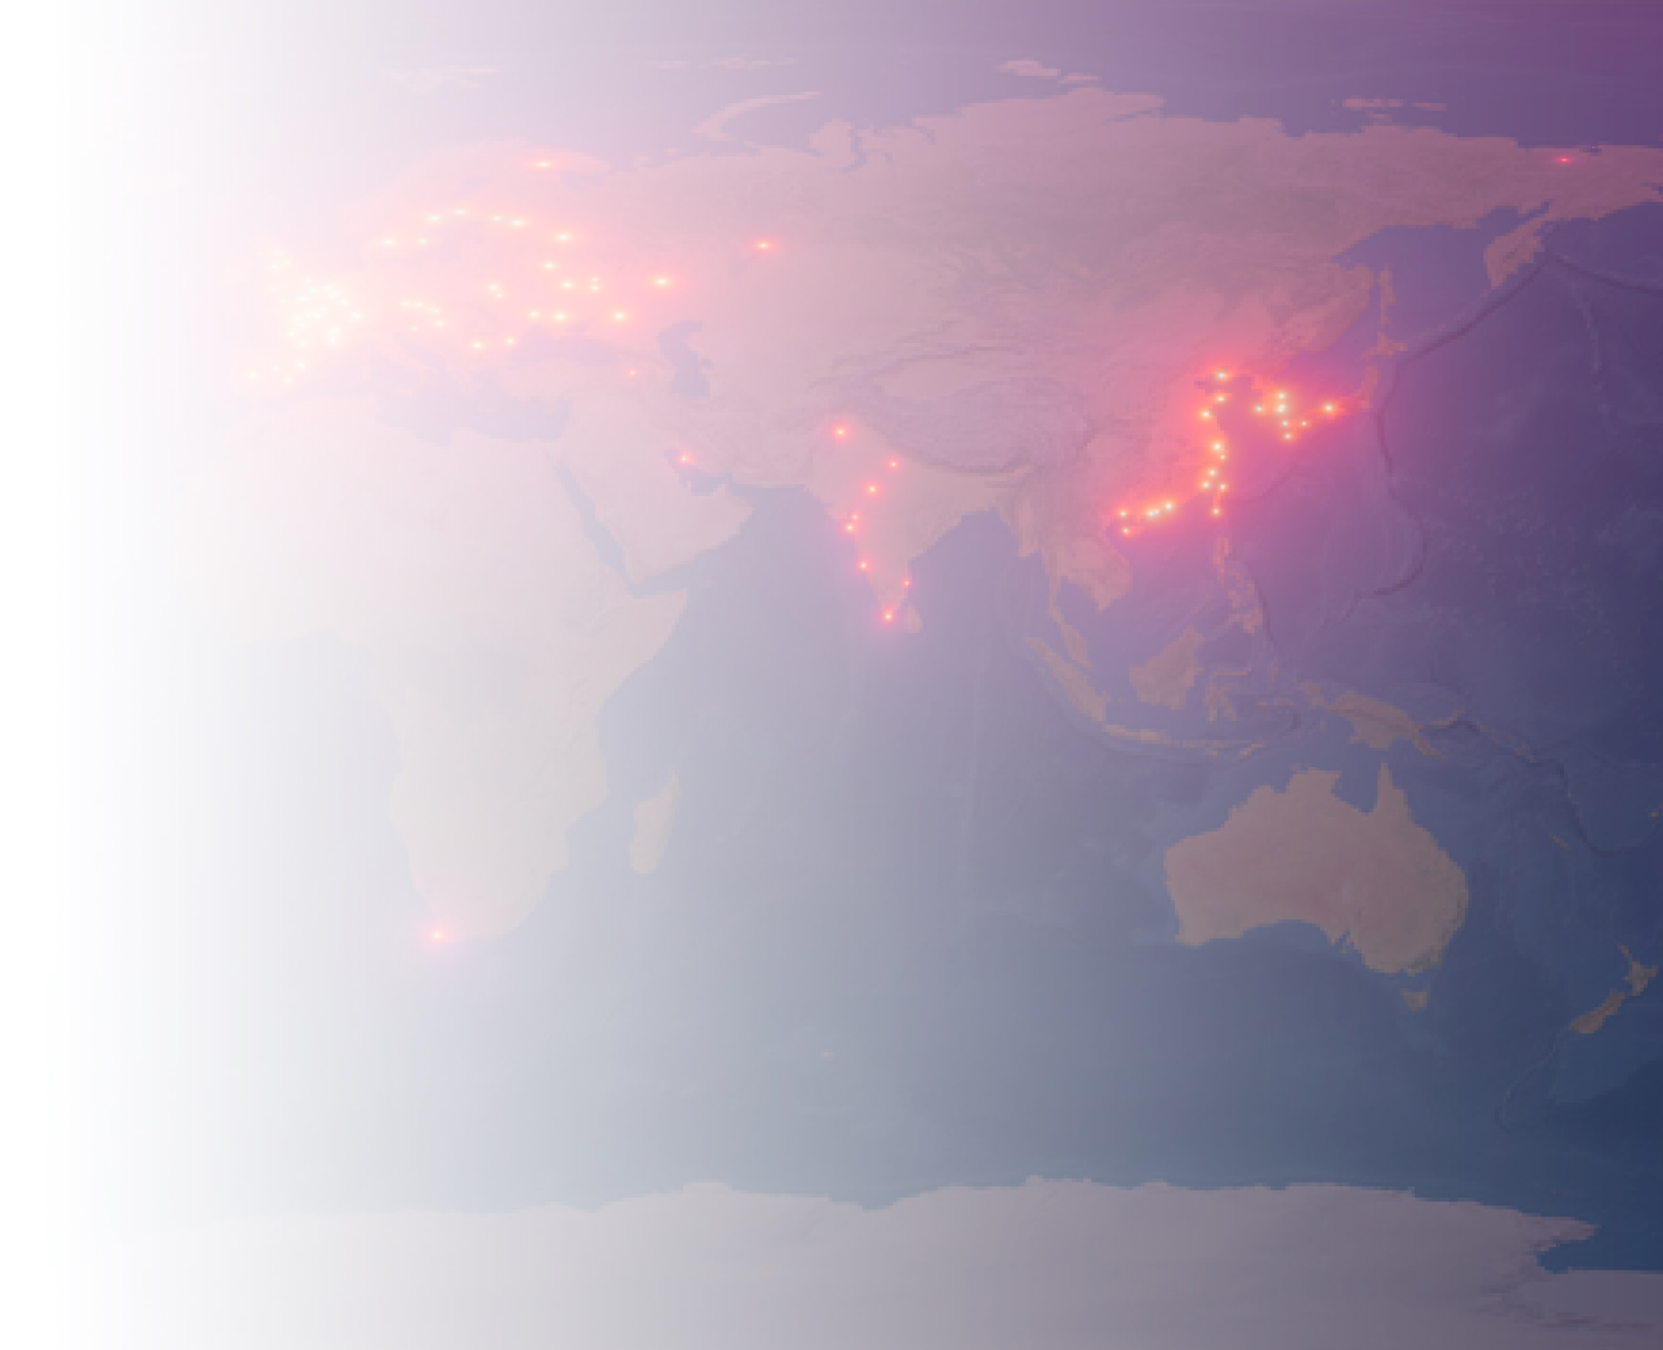
Reactor antineutrino signal in JUNO
28 may 2021
F. Mantovani, M. Montuschi, A. Serafini, V. Strati

Slide 23

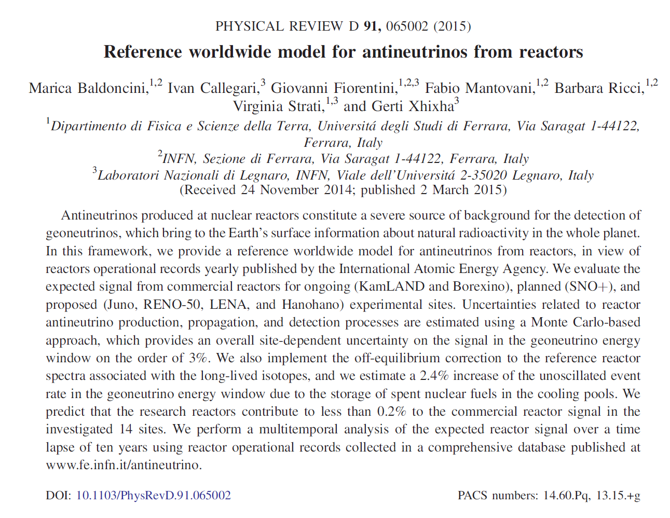
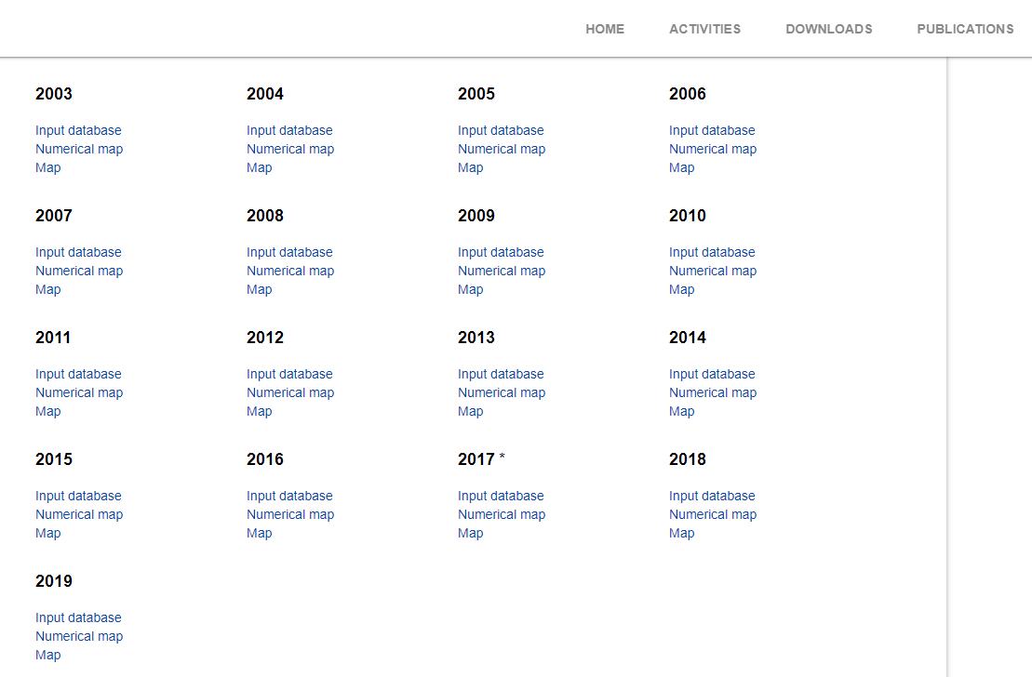
Some useful resources
Global: performance data of all reactors in the world
Monthly Load Factors (%)
Public, official and free
Latitude and longitude of reactors
Multitemporal: time lapse of 17 years (2003 – 2020)
Direct implementation thanks to standard file (ASCII, Excel)
https://www.fe.infn.it/radioactivity/materials/papers/baldoncini2015.pdf
https://www.fe.infn.it/radioactivity/antineutrino/

Slide 24
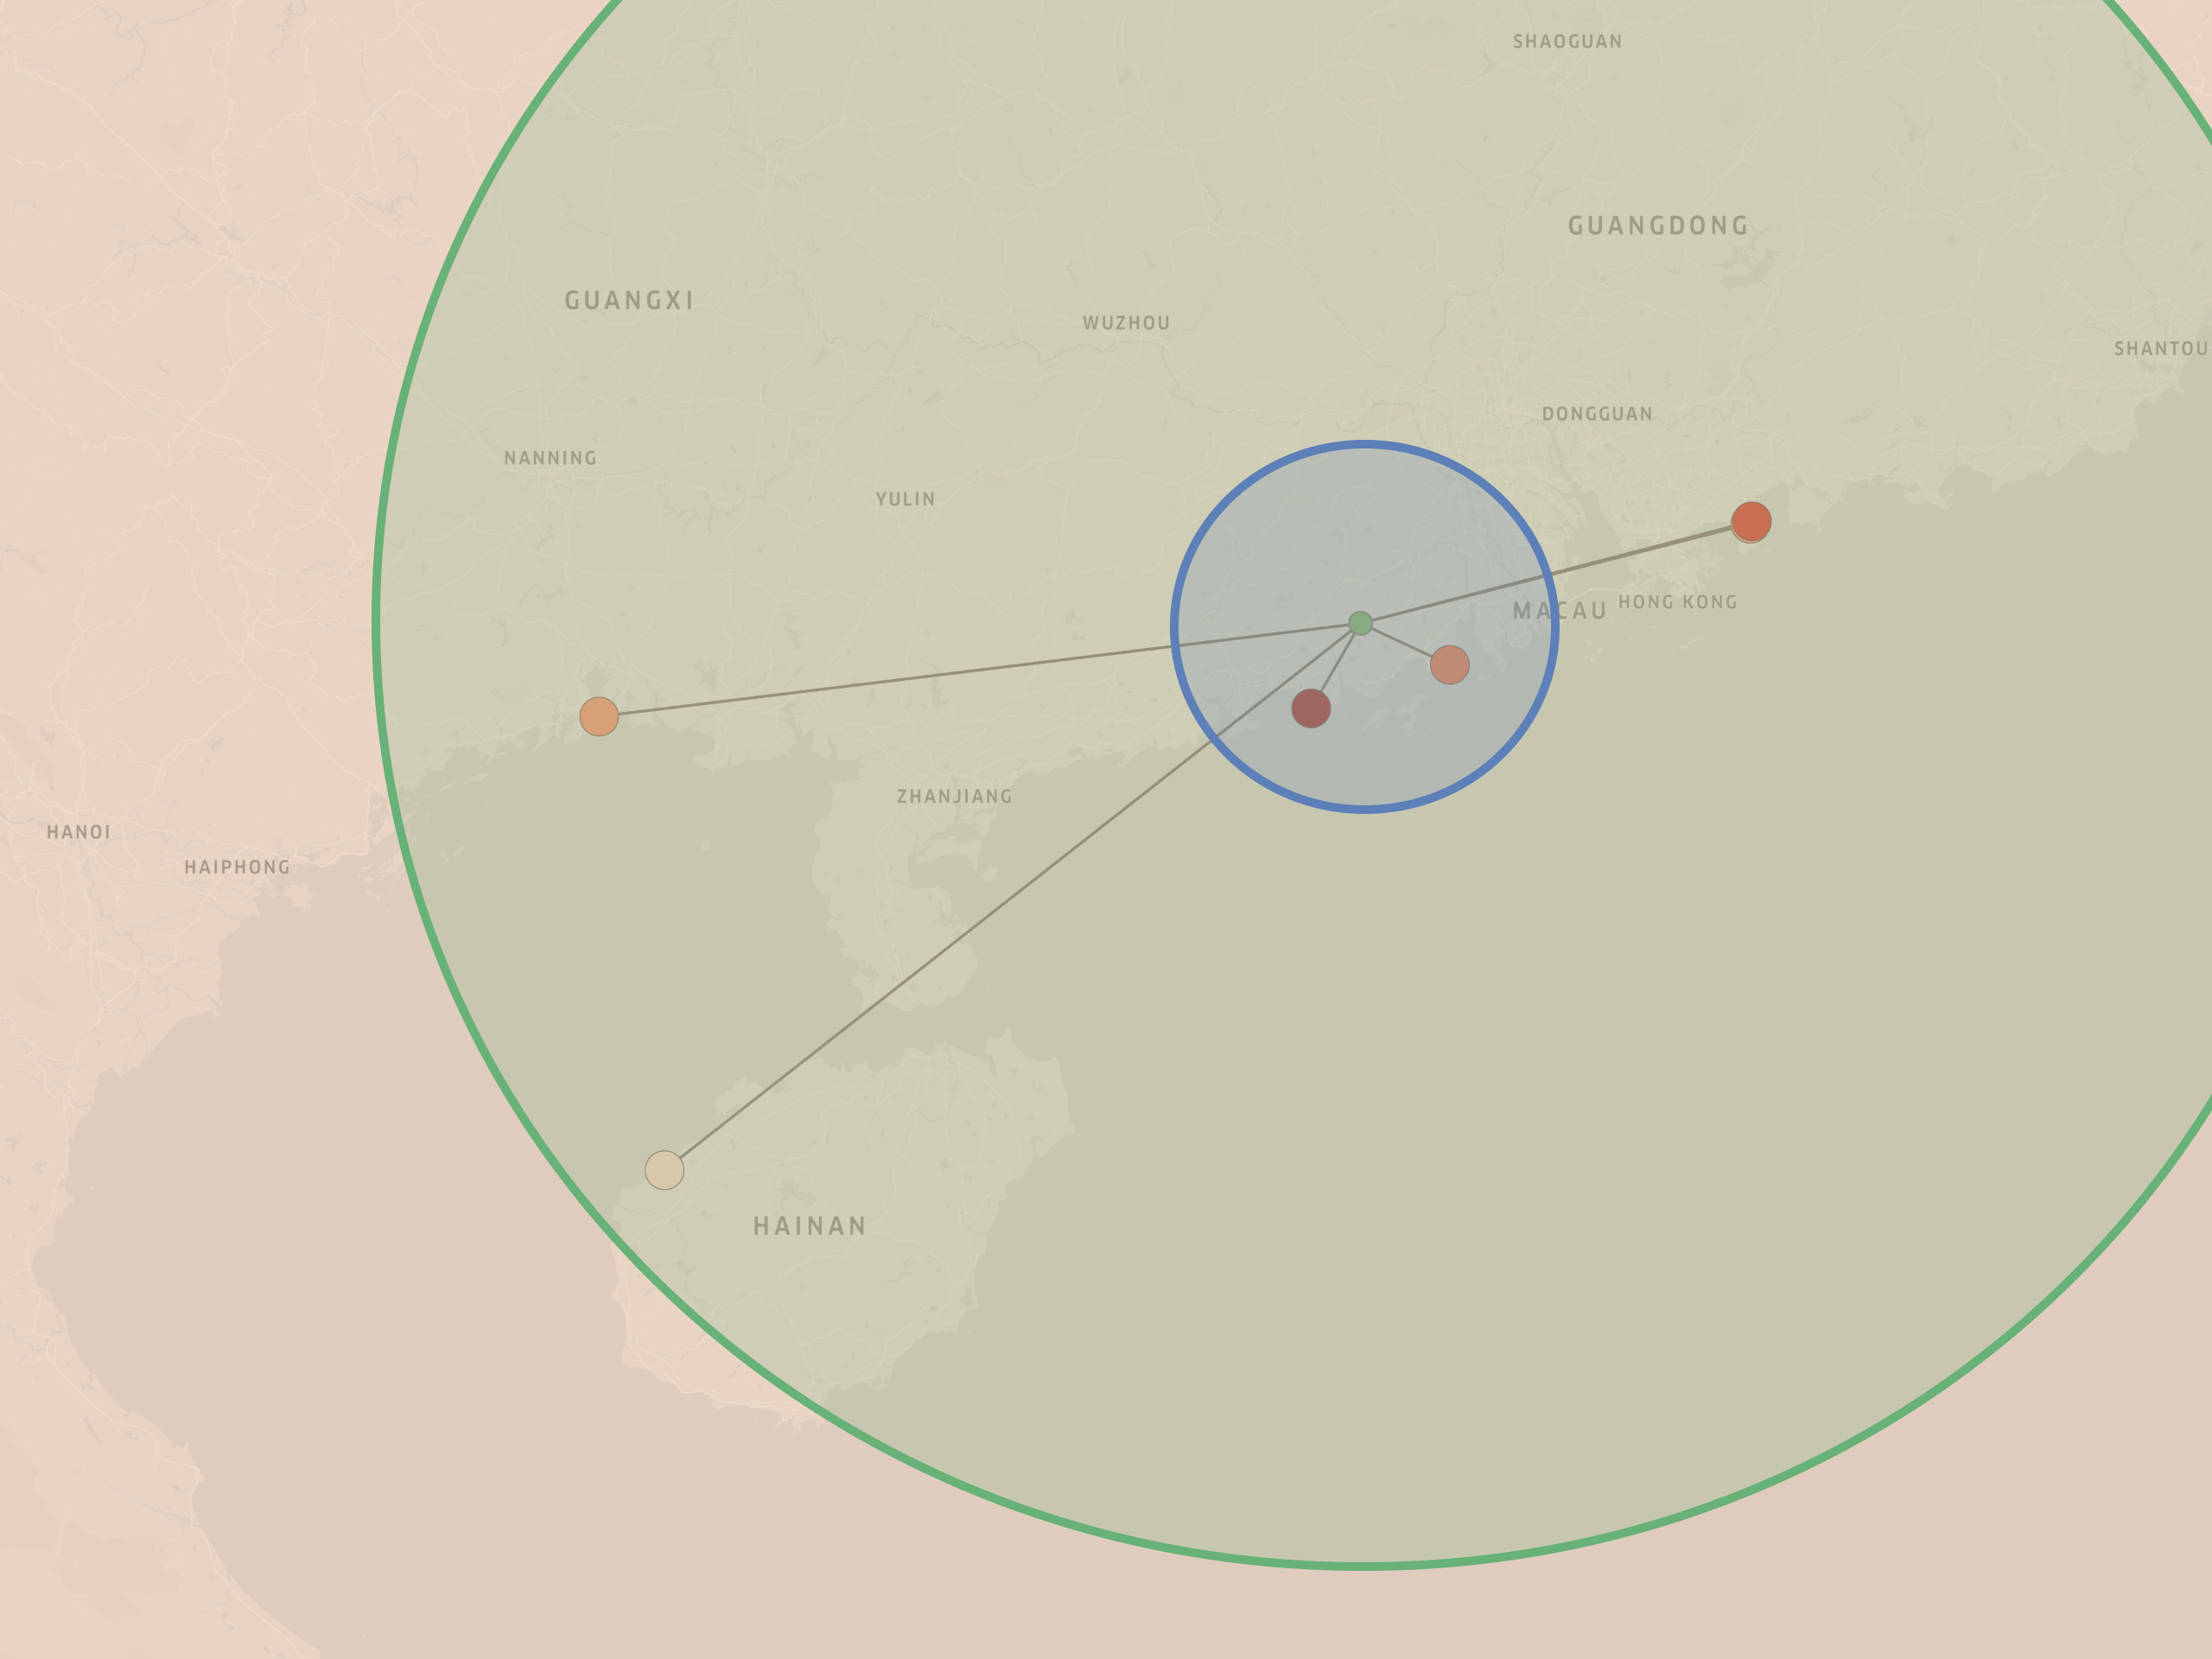
Active reactors within 500 km from JUNO (reactors data updated to 2019)
Name | Number of cores | P_{th} [MW] | Distance [km]
Taishan | 2 | 9180 | 53
Yangjiang | 6 | 17430 | 53
Daya Bay | 2 | 5810 | 215
Ling Ao | 4 | 11620 | 216
Fangchenggang | 2 | 5810 | 411
Changjiang | 2 | 3860 | 478
Others (>500 km)
Far
(55 km - 500 km)
Near
(<55 km)
Ling Ao
JUNO
Daya Bay
Fangchenggang
Taishan
Yangjiang
Changjiang

Slide 25
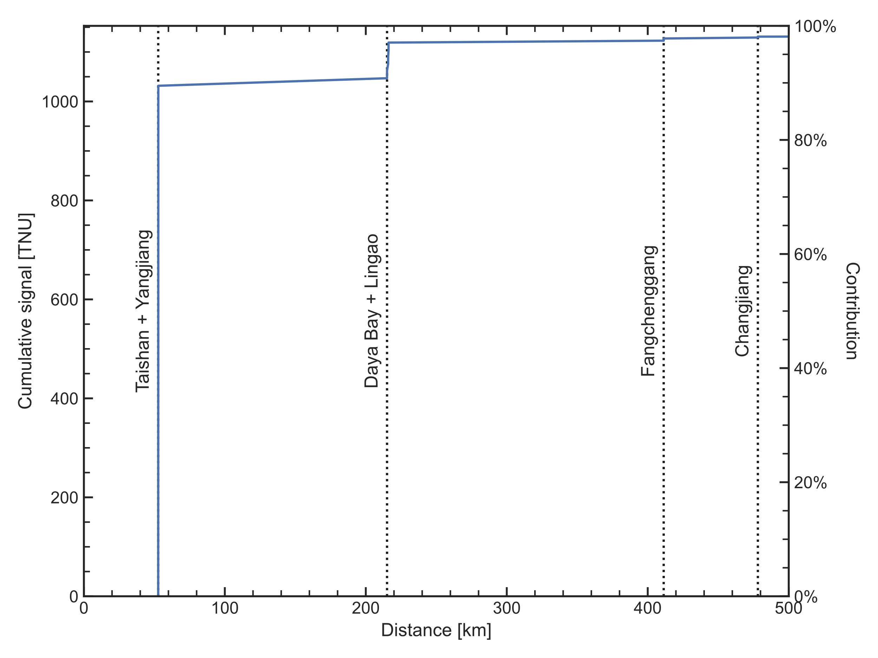
Signal contribution as a function of distance (calculated according to the monthly load factors recorded in 2019, averaged over the entire year)
Name | Signal [TNU]* | Contribution [%]
Taishan | 293.7 | 25.5%
Yangjiang | 738.0 | 64.0%
Daya Bay | 30.7 | 2.7%
Ling Ao | 56.6 | 4.9%
Fangchenggang | 8.3 | 0.7%
Changjiang | 3.7 | 0.3%
Others | 21.8 | 1.9%
Total | 1152.8 | 100%
*1 TNU = 1 event per 10³² target atoms per year with 100% efficiency

Slide 26
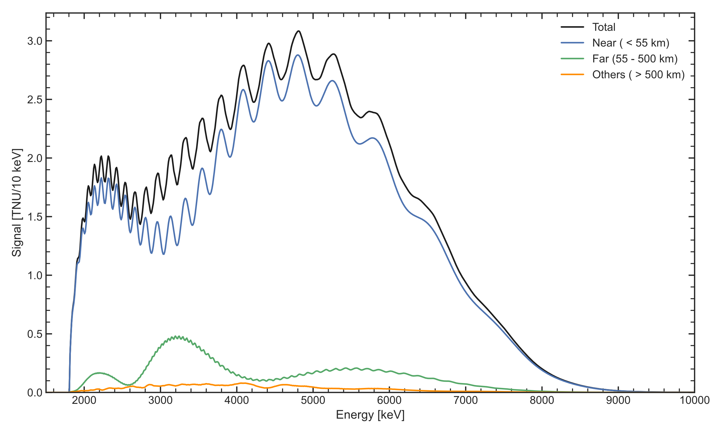
Expected reactor antineutrino spectrum in JUNO (calculated according to the monthly load factors recorded in 2019, averaged over the entire year)

Slide 27
Expected reactor antineutrino spectrum in JUNO (calculated according to the monthly load factors recorded in 2019, averaged over the entire year)

Slide 28
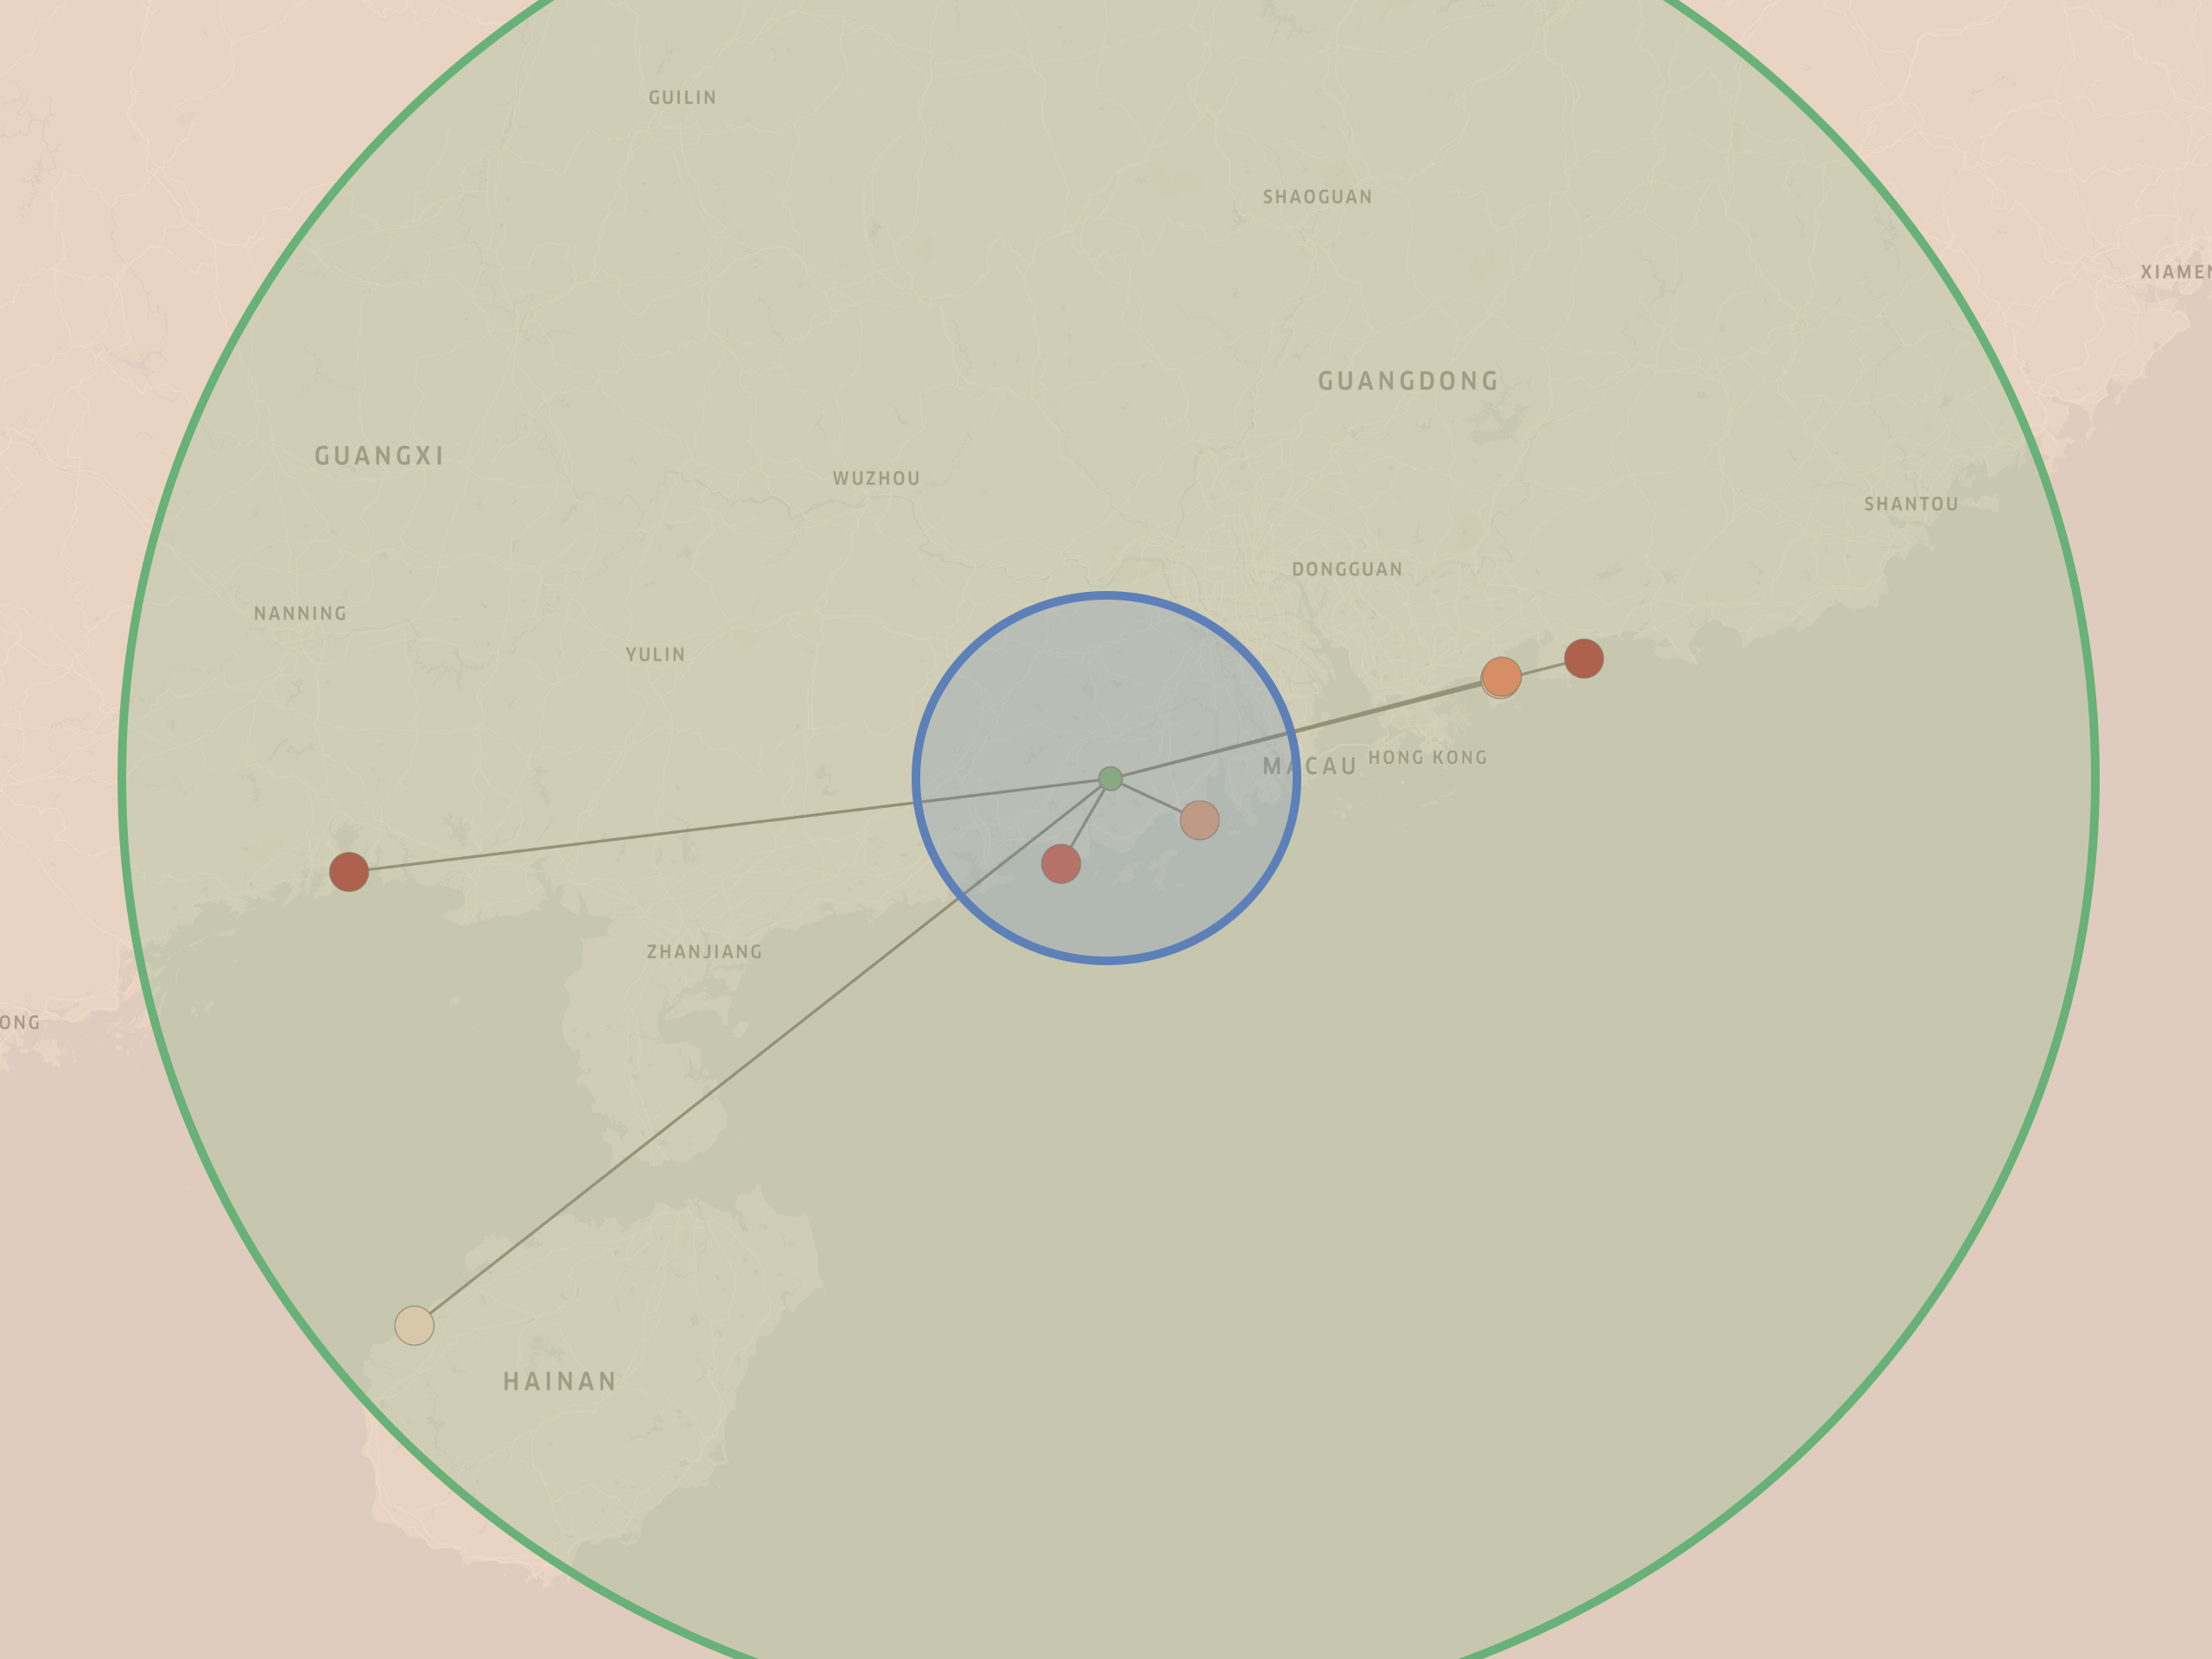
Planned reactors within 500 km from JUNO (reactors data planned for 2026)
Name | Cores | P_{th} [MW] | Distance [km]
Taishan | 2 | 9180 | 53
Yangjiang | 6 | 17430 | 53
Daya Bay | 2 | 5810 | 215
Ling Ao | 4 | 11620 | 216
Taipingling | 6 | 18900 | 261
Fangchenggang | 2 (+4) | 5810 (+12600) | 411
Changjiang | 2 | 3860 | 478
Near
(<55 km)
Ling Ao
Taipingling
JUNO
Fangchenggang
Daya Bay
Taishan
Yangjiang
Far
(55 km - 500 km)
Changjiang
Others (>500 km)

Slide 29
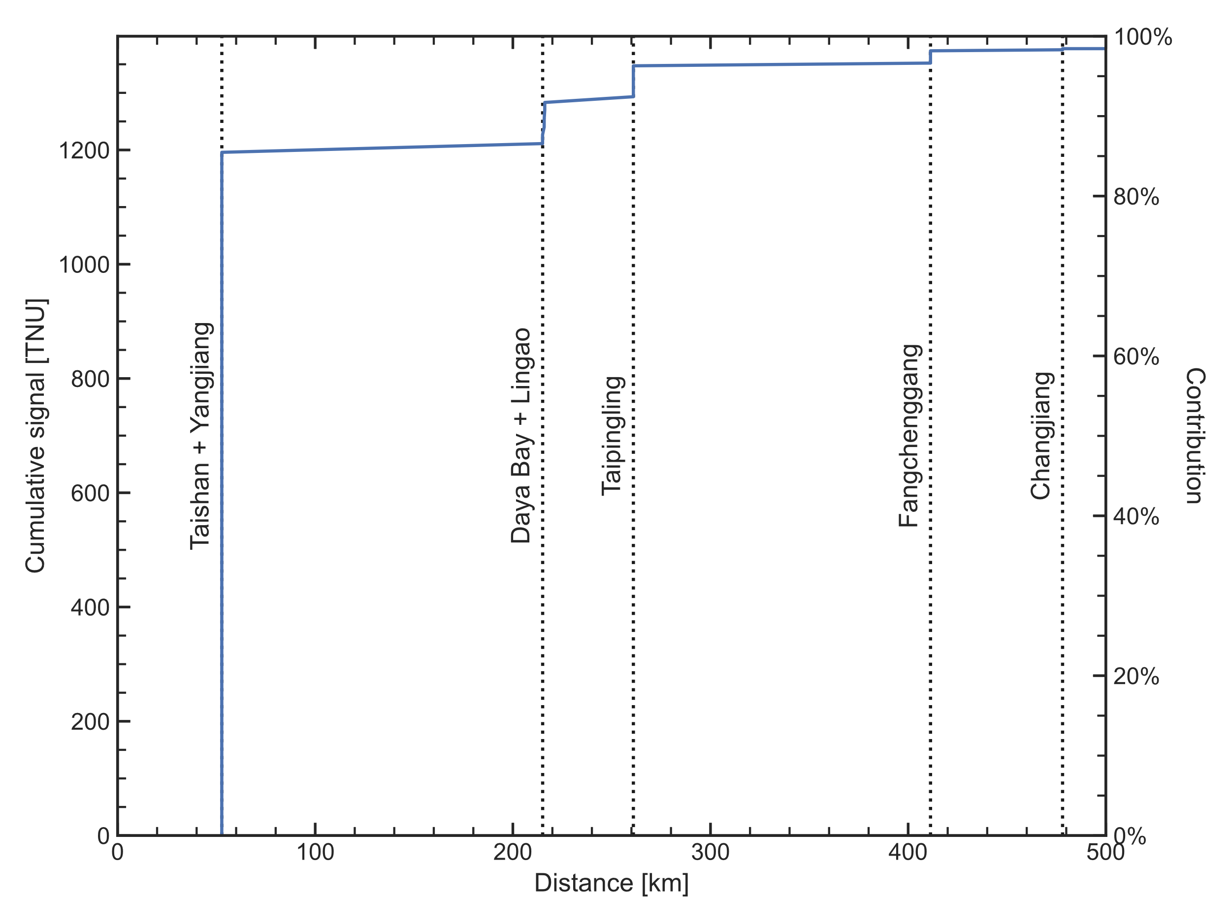
Future (2026) signal contribution as a function of distance (calculated assuming (i) 2019 yearly-averaged load factors for currently active reactors, (ii) nominal thermal powers for planned reactors and (iii) load factors for planned cores assumed to be equal to what registered in 2019 for cores of the same type/model)
Name | Signal [TNU] | Contribution [%]
Taishan | 405.1 | 29.0
Yangjiang | 790.8 | 56.5
Daya Bay | 30.7 | 2.2
Ling Ao | 56.6 | 4.0
Taipingling | 64.2 | 4.6
Fangchenggang | 26.2 | 1.9
Changjiang | 3.7 | 0.3
Others | 21.8 | 1.6
Total | 1399.1 | 100%

Slide 30

Future reactor antineutrino spectrum in JUNO (calculated assuming (i) 2019 yearly-averaged load factors for currently active reactors, (ii) nominal thermal powers for planned reactors and (iii) load factors for planned cores assumed to be equal to what registered in 2019 for cores of the same type/model)

Slide 31

Future reactor antineutrino spectrum in JUNO (calculated assuming (i) 2019 yearly-averaged load factors for currently active reactors, (ii) nominal thermal powers for planned reactors and (iii) load factors for planned cores assumed to be equal to what registered in 2019 for cores of the same type/model)

Slide 32
Possible antineutrino backgrounds for solar neutrinos detection in JUNO
Let’s share our ideas, information and tools

